Slide 1


Modern Operating Systems
Fifth Edition
Chapter 2
Processes and Threads
Copyright © 2023, 2014, 2008 Pearson Education, Inc. All Rights Reserved
Notes:
If this PowerPoint presentation contains mathematical equations, you may need to check that your computer has the following installed:
1) Math Type Plugin
2) Math Player (free versions available)
3) NVDA Reader (free versions available)

Slide 2
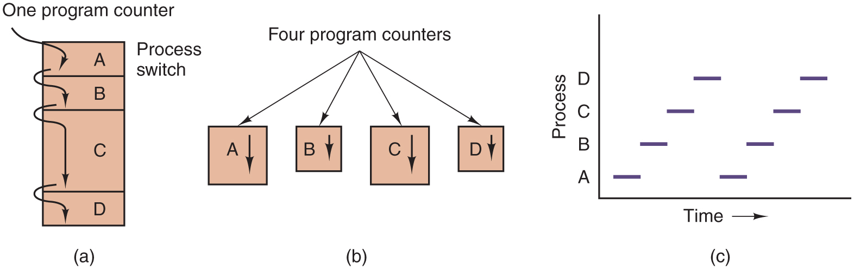
Figure 2.1
(a) Multiprogramming four programs. (b) Conceptual model of four independent, sequential processes. (c) Only one program is active at once.
Notes:
Long Description:
Part (a): A vertical rectangular block labeled One program counter has four partitions, out of which the third partition is large. The partitions from top to bottom are labeled A, B, C, and D. Partition A is labeled Process switch. Four downward arrows point to each block individually, starting from one program counter to A, A to B, B to C, and C to D. Part (b): Four vertical rectangular blocks have arrows starting from a point labeled Four program counters. The four blocks are labeled A, B, C, and D and all blocks are marked with downward arrows. Part (c): Graph: The horizontal axis is labeled Time. The vertical axis is labeled Process. The range of processes is A, B, C, and D. Two sets of horizontal bars are marked at every process in the form of low to high step ladder.

Slide 3
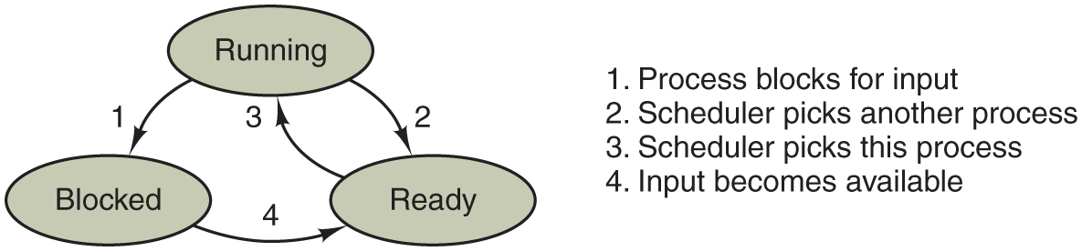
Figure 2.2
A process can be in running, blocked, or ready state. Transitions between these states are as shown.
Notes:
Long Description:
Transitions between the three states are as shown. There are three oval-shaped blocks labeled Running, Blocked, and Ready. The Running block is placed on top while the other two blocks are placed at the lower left and lower right. There are two downward arrows from running: an arrow labeled 1 points to Blocked and the other arrow labeled 2 points to Ready. An arrow labeled 3 from Ready points to Running block. An arrow labeled 4 from Blocked points to Ready. The description of arrows is mentioned on the right side of the diagram: 1. Process blocks for input. 2. Scheduler picks another process. 3. Scheduler picks this process. 4. Input becomes available.

Slide 4
Process Creation
Four principal events that cause processes to be created:
System initialization.
Execution of a process creation system call by a running process.
A user request to create a new process.
Initiation of a batch job.

Slide 5
Process Termination
Typical conditions which terminate a process:
Normal exit (voluntary).
Error exit (voluntary).
Fatal error (involuntary).
Killed by another process (involuntary).

Slide 6
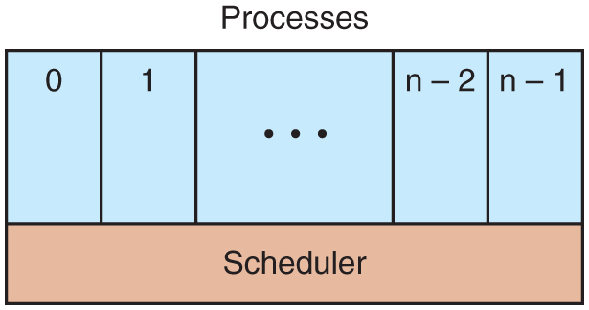
Figure 2.3
The lowest layer of a process-structured operating system handles interrupts and scheduling. Above that layer are sequential processes.
Notes:
Long Description:
There is a rectangular block labeled Processes with five vertical partitions and one horizontal partition. The first vertical partition is labeled 0, the second is labeled 1, the third is labeled so on depicted by three dots, the fourth is labeled n minus 2 and the fifth is labeled n minus 1. The horizontal partition is labeled Scheduler.

Slide 7
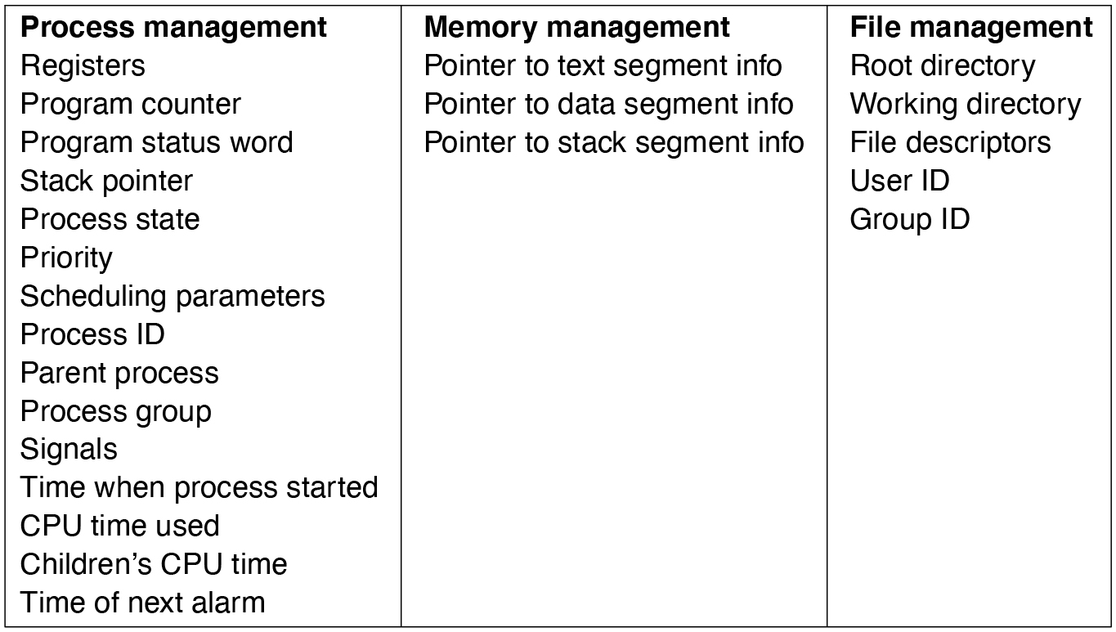
Figure 2.4
Some of the fields of a typical process-table entry.
Notes:
Long Description:
<html> <head> <style type="text/css"> th{ border: 1px solid black; } tr th { padding:4px; } td{ padding:4px; } </style> </head> <body> <table border="1"><tr><th>Process management </th><th>Memory management </th><th>File management </th></tr><tr><td>Registers </td><td>Pointer to text segment info </td><td>Root directory </td></tr><tr><td>Program counter </td><td>Pointer to data segment info </td><td>Working directory </td></tr><tr><td>Program status word </td><td>Pointer to stack segment info </td><td>File descriptors </td></tr><tr><td>Stack pointer </td><td></td><td>User ID </td></tr><tr><td>Process state </td><td></td><td>Group ID </td></tr><tr><td>Priority </td><td></td><td></td></tr><tr><td>Scheduling parameters </td><td></td><td></td></tr><tr><td>Process ID </td><td></td><td></td></tr><tr><td>Parent process </td><td></td><td></td></tr><tr><td>Process group </td><td></td><td></td></tr><tr><td>Signals </td><td></td><td></td></tr><tr><td>Time when process started </td><td></td><td></td></tr><tr><td>CPU time used </td><td></td><td></td></tr><tr><td>Children's CPU time </td><td></td><td></td></tr><tr><td>Time of next alarm </td><td></td><td></td></tr></table></body></html>

Slide 8
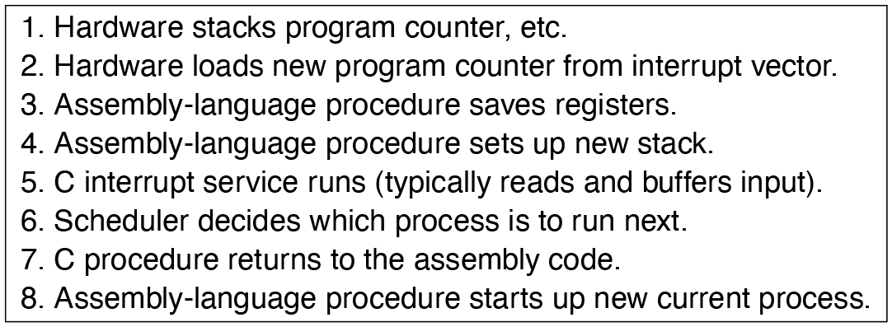
Figure 2.5
Skeleton of what the lowest level of the operating system does when an interrupt occurs. The details may vary between operating systems.
Notes:
Long Description:
<html> <head> <style type="text/css"> th{ border: 1px solid black; } tr th { padding:4px; } td{ padding:4px; } </style> </head> <body> <table border="1"><tr><td>1. Hardware stacks program counter, etc.</td></tr><tr><td>2. Hardware loads new program counter from interrupt vector. </td></tr><tr><td>3. Assembly-language procedure saves registers. </td></tr><tr><td>4. Assembly-language procedure sets up new stack. </td></tr><tr><td>5. C interrupt service runs (typically reads and buffers input). </td></tr><tr><td>6. Scheduler decides which process is to run next. </td></tr><tr><td>7. C procedure returns to the assembly code. </td></tr><tr><td>8. Assembly-language procedure starts up new current process. </td></tr></table></body></html>

Slide 9
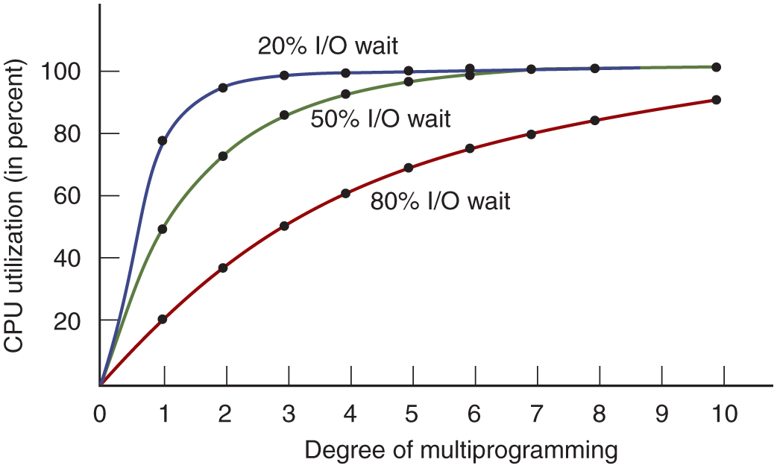
Figure 2.6
C P U utilization as a function of the number of processes in memory.
Notes:
Long Description:
The horizontal axis is labeled Degree of multiprogramming and ranges from 0 to 10 in increments of 1 unit. The vertical axis is labeled C P U utilization (in percent) and ranges from 0 to 100 in increments of 20 units. Three different curves are shown here. The first curve labeled 20 percent I/O wait starts at (0, 0), rises toward the upper right, is concave downward, then rises linearly to the point (1, 80), bends, moves horizontally, and ends at (10, 100). The curve passes approximately through the following points: (1, 80), (2, 95), (3, 100), (4, 100), (5, 100), (6, 100), (7, 100), (8, 100), and (10, 100). The second curve labeled 50 percent I/O wait, starts at (0, 0), rises upward to the right, is concave downward, then merges with the first curve at the point (6, 100) and ends at (10, 100). Several points are marked on this curve as follows: (1, 50), (2, 70), (3, 85), (5, 95), and (8, 100). The third curve labeled 80 percent I/O wait starts at (0, 0), rises toward the upper right, is concave upward, and ends at (10, 100). The curve passes through the following points: (1, 20), (2, 40), (3, 50), (5, 70), (6, 75), (7, 80), and (8, 95).

Slide 10
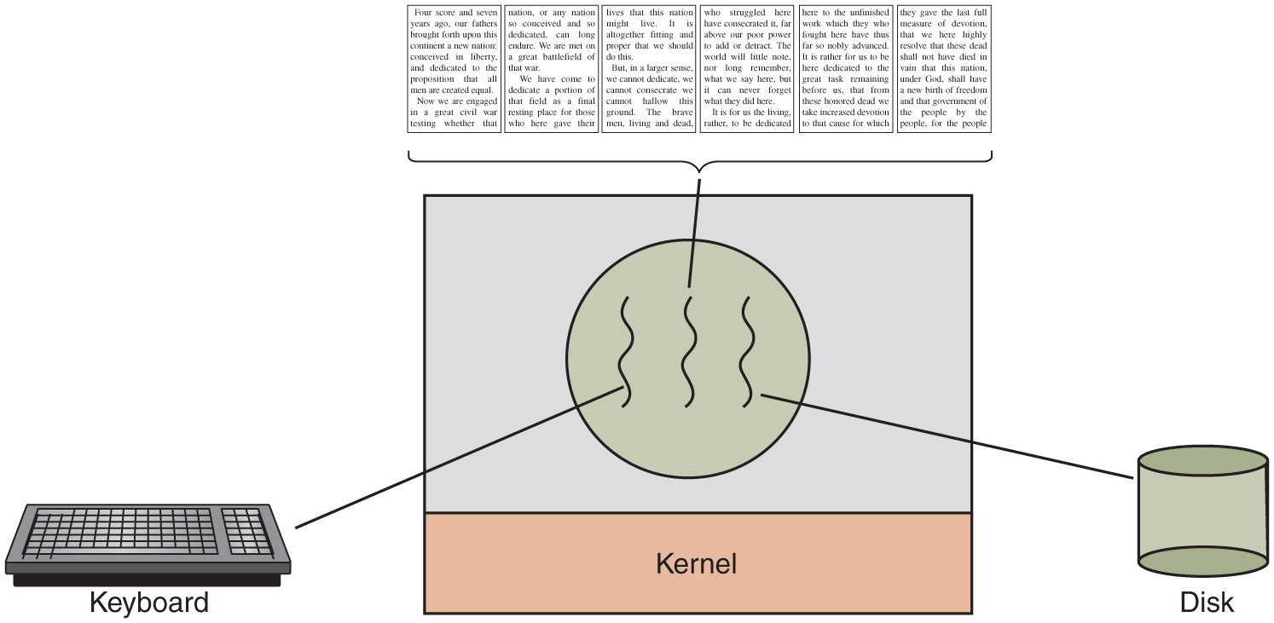
Figure 2.7
A word processor with three threads.
Notes:
Long Description:
The image consists of a square block in the center with two horizontal partitions. A circle with three wavy lines is in the first partition and the second partition is labeled kernel. There is a keyboard on the left connected with the first wavy line in the circle and a cylindrical disk on the right connected with the third wavy line of a circle. Six pages of a book are shown on the top of the square and are connected with the center wavy line of a circle. The first page states that "Four score and seven years ago, our fathers brought forth upon this continent a new nation: conceived in liberty, and dedicated to the proposition that all men are created equal. Now we are engaged in a great civil war testing whether that." The second page states that "nation, or any nation so conceived and so dedicated, can long endure. We are met on a great battlefield of that war. We have come to dedicate a portion of that field as a final resting place for those who here gave their." The third page states that "lives that this nation might live. It is altogether fitting and proper that we should do this. But, in a larger sense, we cannot dedicate, we cannot consecrate we cannot hallow this ground. The brave men, living and dead." The fourth page states that "who struggled here have consecrated it, far above our poor power to add or detract. The world will little note, nor long remember, what we say here, but it can never forget what they did here. It is for us the living, rather, to be dedicated." The fifth page states that "here to the unfinished work which they who fought here have thus far so nobly advanced. It is rather for us to be here dedicated to the great task remaining before us, that from these honored dead we take increased devotion to that cause for which." The sixth page states that "they gave the last full measure of devotion, that we here highly resolve that these dead shall not have died in vain that this nation, under God, shall have a new birth of freedom and that government of the people by the people, for the people."

Slide 11
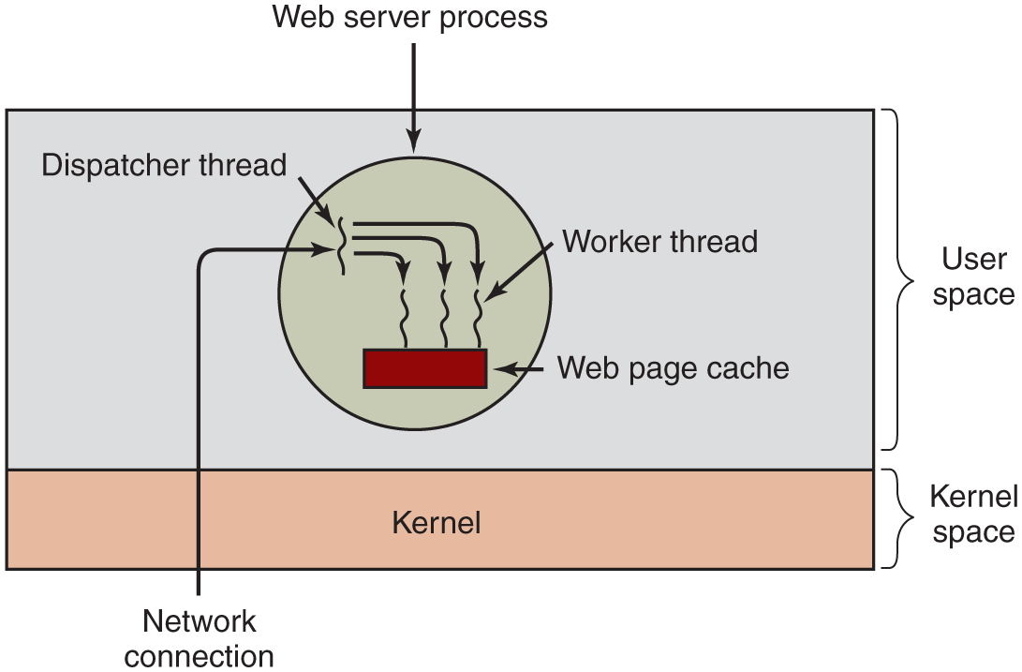
Figure 2.8
A multithreaded Web server.
Notes:
Long Description:
There is a rectangular block with two horizontal partitions. The first partition has a circle labeled Web server process with three wavy lines placed on a small rectangular block labeled Web page cache. There is a fourth wavy line in the upper left region of the circle labeled Dispatcher thread and an outside Network connection also points to it with a forward arrow. There are three downward arrows from this fourth wavy line that points to three wavy lines in a circle. The third wavy line in a circle is labeled worker thread. The second partition is labeled Kernel. The first partition is categorized as User-space and the second partition is categorized as Kernel space.

Slide 12
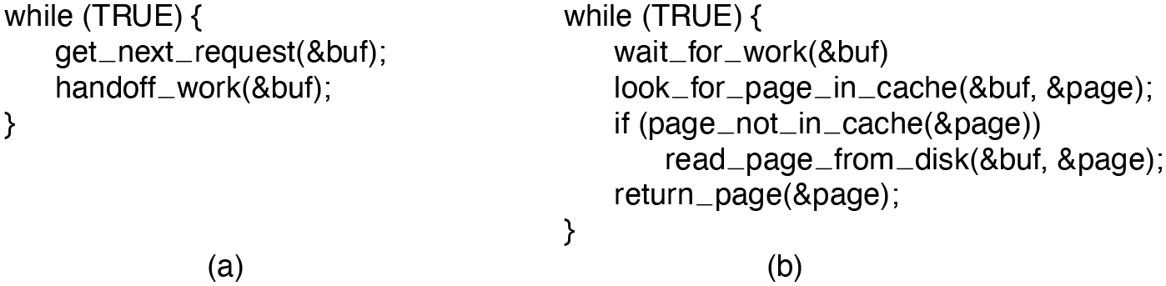
Figure 2.9
A rough outline of the code for Fig. 2.8. (a) Dispatcher thread. (b) Worker thread.
Notes:
Long Description:
The 4 line of code for figure a are as follows.
while open parenthesis TRUE close parenthesis open curly bracket
get under score next under score request open parenthesis ampersand buf close parenthesis semi colon
handoff under score work open parenthesis ampersand buf close parenthesis semi colon
close curly bracket
The 7 lines of code for figure open parenthesis b close parenthesis are as follow
while open parenthesis TRUE close parenthesis open curly bracket
wait under score for under score work open parenthesis &buf close parenthesis
look under score for under score page under score in under score cache open parenthesis ampersand buf coma ampersand page close parenthesis semi colon
if open parenthesis page under score not under score in under score cache open parenthesis ampersand page close parenthesis close parenthesis
read under score page under score from under score disk open parenthesis ampersand buf coma ampersand page close parenthesis semi colon
return under score page open parenthesis ampersand page close parenthesis semi colon
close curly bracket

Slide 13
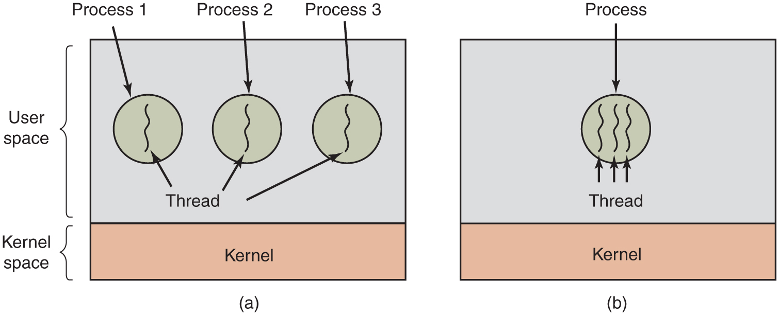
Figure 2.10
(a) Three processes each with one thread. (b) One process with three threads.
Notes:
Long Description:
Part (a): There is a rectangular block with two horizontal partitions. The top first partition has three circles labeled Process 1, Process 2, and Process 3 with one wavy line in each circle labeled Thread. The second partition is labeled Kernel. The first partition is categorized as User-space and the second partition is categorized as kernel space. Part (b): There is a rectangular block with two horizontal partitions. The top first partition has a circle labeled Process with three wavy lines, each labeled Thread. The second partition is labeled Kernel.

Slide 14
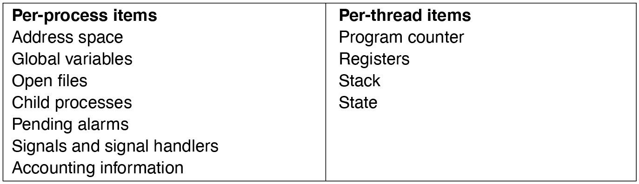
Figure 2.11
The first column lists some items shared by all threads in a process. The second one lists some items private to each thread.
Notes:
Long Description:
<html> <head> <style type="text/css"> th{ border: 1px solid black; } tr th { padding:4px; } td{ padding:4px; } </style> </head> <body> <table border="1"><tr><td>Per-process items </td><td>Per-thread items </td></tr><tr><td>Address space </td><td>Program counter </td></tr><tr><td>Global variables </td><td>Registers </td></tr><tr><td>Open files </td><td>Stack </td></tr><tr><td>Child processes </td><td>State </td></tr><tr><td>Pending alarms </td><td></td></tr><tr><td>Signals and signal handlers </td><td></td></tr><tr><td>Accounting information </td><td></td></tr></table></body></html>

Slide 15
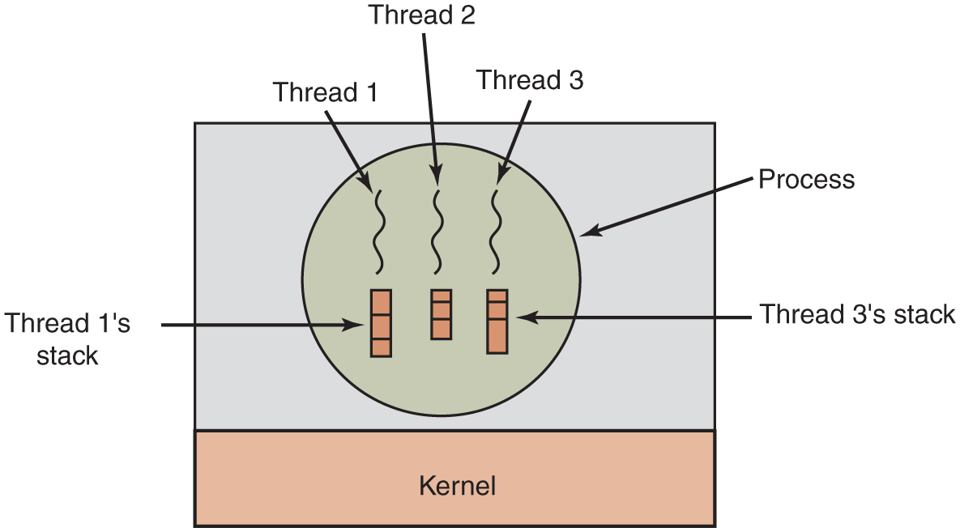
Figure 2.12
Each thread has its own stack.
Notes:
Long Description:
There is a rectangular block with two horizontal partitions. The top first partition has a circle labeled Process with three wavy lines labeled Thread 1, Thread 2, and Thread 3, inside the circle. There are three vertical rectangular blocks with three horizontal partitions. The first vertical rectangular block labeled Thread 1's stack and the third labeled Thread 3's stack. The second partition is labeled Kernel.

Slide 16
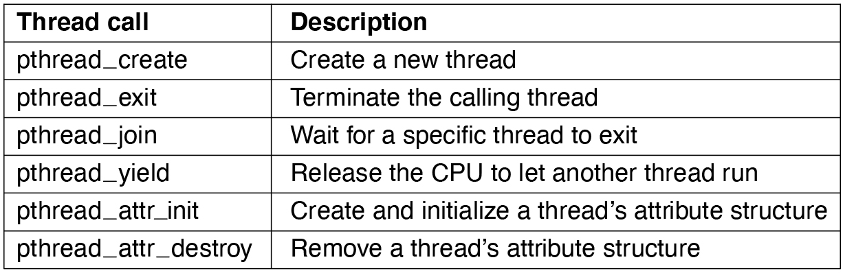
Figure 2.13
Some of the Pthreads function calls.
Notes:
Long Description:
<html> <head> <style type="text/css"> th{ border: 1px solid black; } tr th { padding:4px; } td{ padding:4px; } </style> </head> <body> <table border="1"><tr><th>Thread call</th><th>Description</th></tr><tr><td>pthread_create </td><td>Create a new thread </td></tr><tr><td>pthread_exit </td><td>Terminate the calling thread </td></tr><tr><td>pthread_join </td><td>Wait for a specific thread to exit </td></tr><tr><td>pthread_yield </td><td>Release the CPU to let another thread run </td></tr><tr><td>pthread_attr_init </td><td>Create and initialize a thread's attribute structure </td></tr><tr><td>pthread_attr_destroy </td><td>Remove a thread's attribute structure </td></tr></table></body></html>

Slide 17
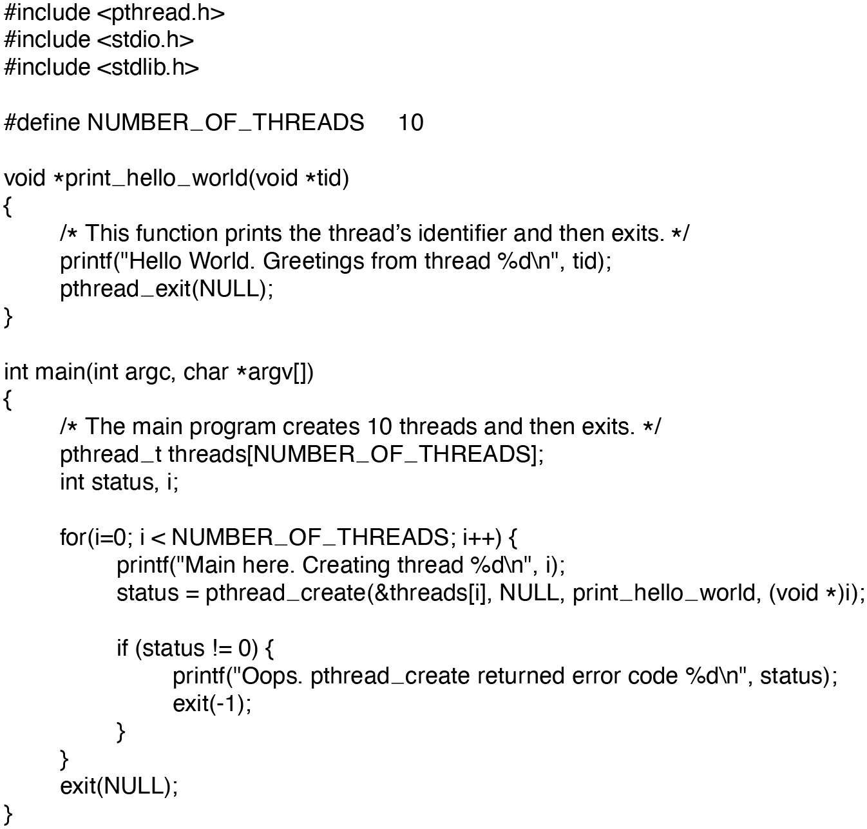
Figure 2.14
An example program using threads.
Notes:
Long Description:
The 25 lines of code are as follows.
hash include open angle bracket pthread.h close angle bracket
hash include open angle bracket stdio.h close angle bracket
hash include open angle bracket stdlib.h close angle bracket
hash define NUMBER under score OF under score THREADS 10
void asterisk print under score hello under score world open parenthesis void asterisk tid close parenthesis
open curly bracket
forward slash asterisk This function prints the thread's identifier and then exits. asterisk forward slash
printf open parenthesis double quote Hello World. Greetings from thread percent d backward slash n double quote coma tid close parenthesis semi colon
pthread under score exit open parenthesis NULL close parenthesis semi colon
close curly bracket
int main open parenthesis int argc coma char asterisk argvopen close box bracket close parenthesis
open curly bracket
forward slash asterisk The main program creates 10 threads and then exits. asterisk forward slash
pthread under score t threadsopen box bracket NUMBER under score OF under score THREADSclose box bracket semi colon
int status coma i semi colon
for open parenthesis i equals to 0 semi colon i less than NUMBER under score OF under score THREADS semi colon i plus plus close parenthesis open curly bracket
printf open parenthesis double quote Main here. Creating thread percent d backward slash n double quote coma i close parenthesis semi colon
status equals to pthread under score create open parenthesis &threadsopen box bracket i close box bracket coma NULL coma print under score hello under score world coma open parenthesis void asterisk close parenthesis i close parenthesis
if open parenthesis status exclamation mark equals to 0 close parenthesis open curly bracket
printf open parenthesis double quote Oops. pthread under score create returned error code percent d backward slash n double quote coma status close parenthesis semi colon
exit open parenthesis negative 1 close parenthesis semi colon
close curly bracket
close curly bracket
exit open parenthesis NULL close parenthesis semi colon
close curly bracket

Slide 18
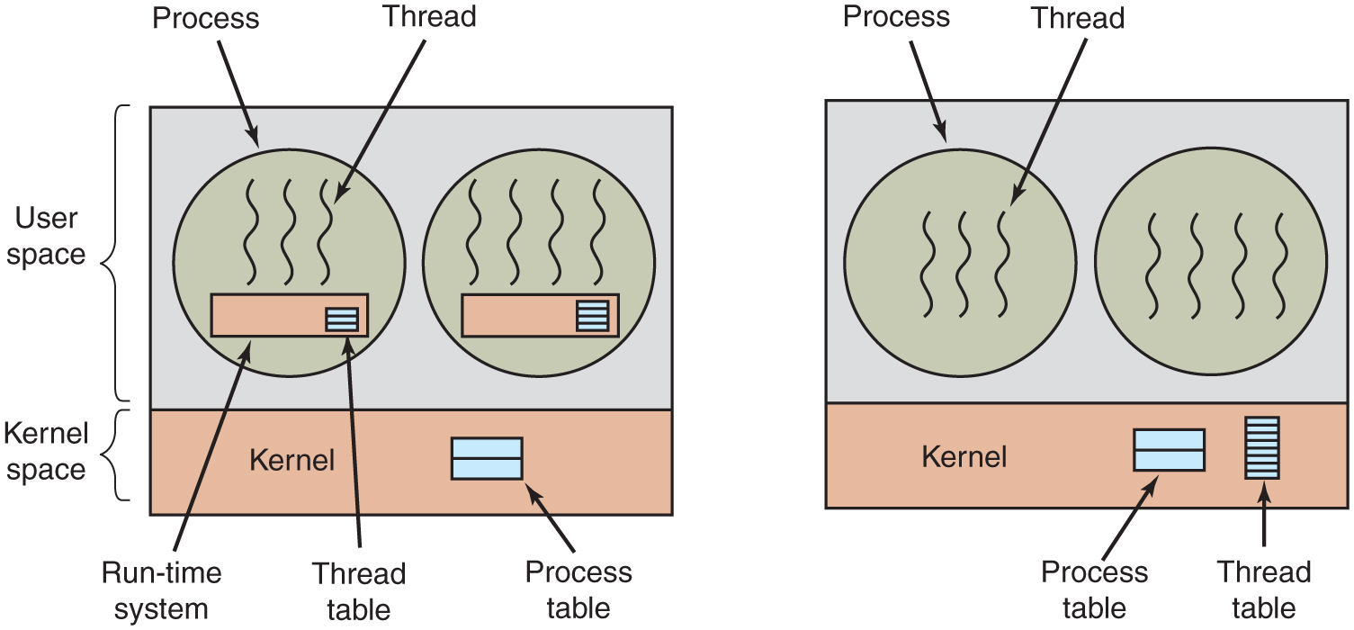
Figure 2.15
(a) A user-level threads package. (b) A threads package managed by the kernel.
Notes:
Long Description:
The image consists of two parts. Part 1: There is a rectangular block with two horizontal partitions. The first partition is categorized as User-space and the second is kernel space. The top first partition has two circles. The first circle labeled Process has three vertical wavy lines labeled Thread. There is a rectangular block labeled Run time system with another small block labeled Thread table with three partitions. The second circle is the same as the first one, except that there is an extra wavy line in the circle. The second partition is labeled Kernel and a block with two horizontal partitions labeled Process table. Part 2: It is the same as part 1 except that there are no rectangular blocks in both circles. A rectangular block labeled thread table has many partitions is at the lower right end of the kernel space.

Slide 19
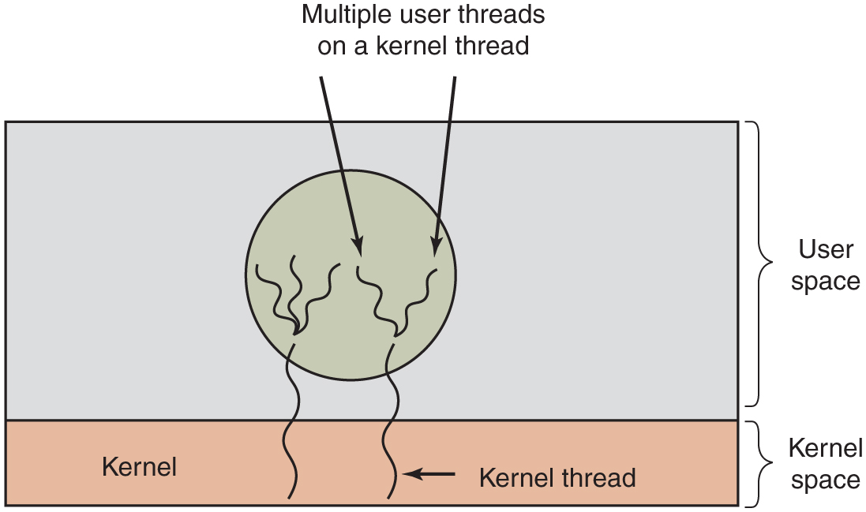
Figure 2.16
Multiplexing user-level threads onto kernel-level threads.
Notes:
Long Description:
A rectangular block has two horizontal partitions. The top first partition has a circle with multiple vertical wavy lines labeled Multiple user threads on a kernel thread. The second partition is labeled Kernel and two vertical wavy lines labeled kernel thread from the circle in the first partition enter the second partition. The first partition is categorized as User-space and the second partition is categorized as kernel space.

Slide 20
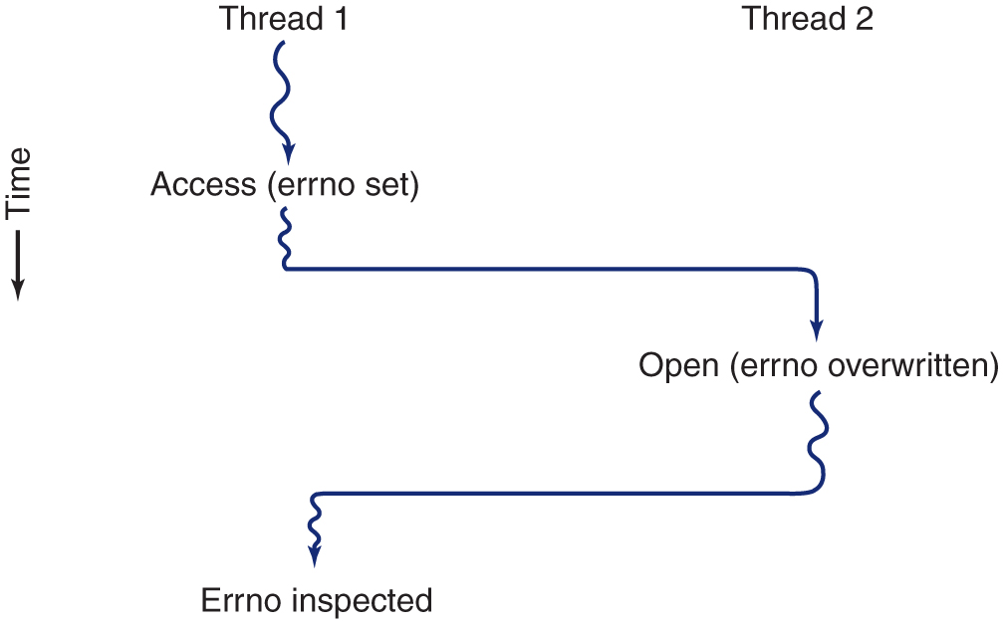
Figure 2.17
Conflicts between threads over the use of a global variable.
Notes:
Long Description:
There are two vertical wavy lines labeled Thread 1 and thread 2. The vertical direction depicts time. Thread 1 is split into two parts and one of the parts is labeled Access (Errno set). Thread 1 then travels toward the right for a while, bends down with a downward arrow labeled Open (Errno overwritten). Then thread 2 travels toward the left for a while, bends down with a downward wavy arrow labeled Errno Inspected.

Slide 21
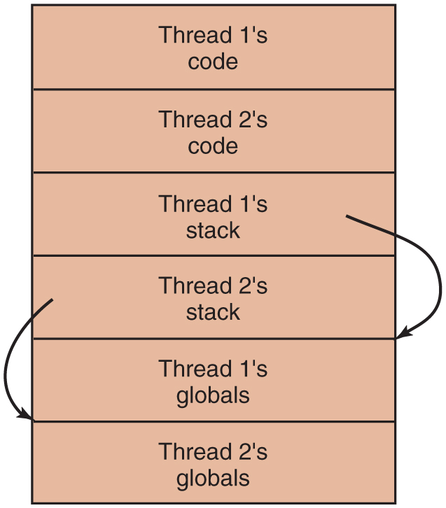
Figure 2.18
Threads can have private global variables.
Notes:
Long Description:
A rectangular block has six partitions from top to bottom labeled Thread 1's code, Thread 2's code, Thread 1's stack, Thread 2's stack, Thread 1's globals, and Thread 2's globals. A circular arrow from Thread 1's stack points to Thread 1's globals. Another circular arrow from Thread 2's stack points to Thread 2's globals.

Slide 22
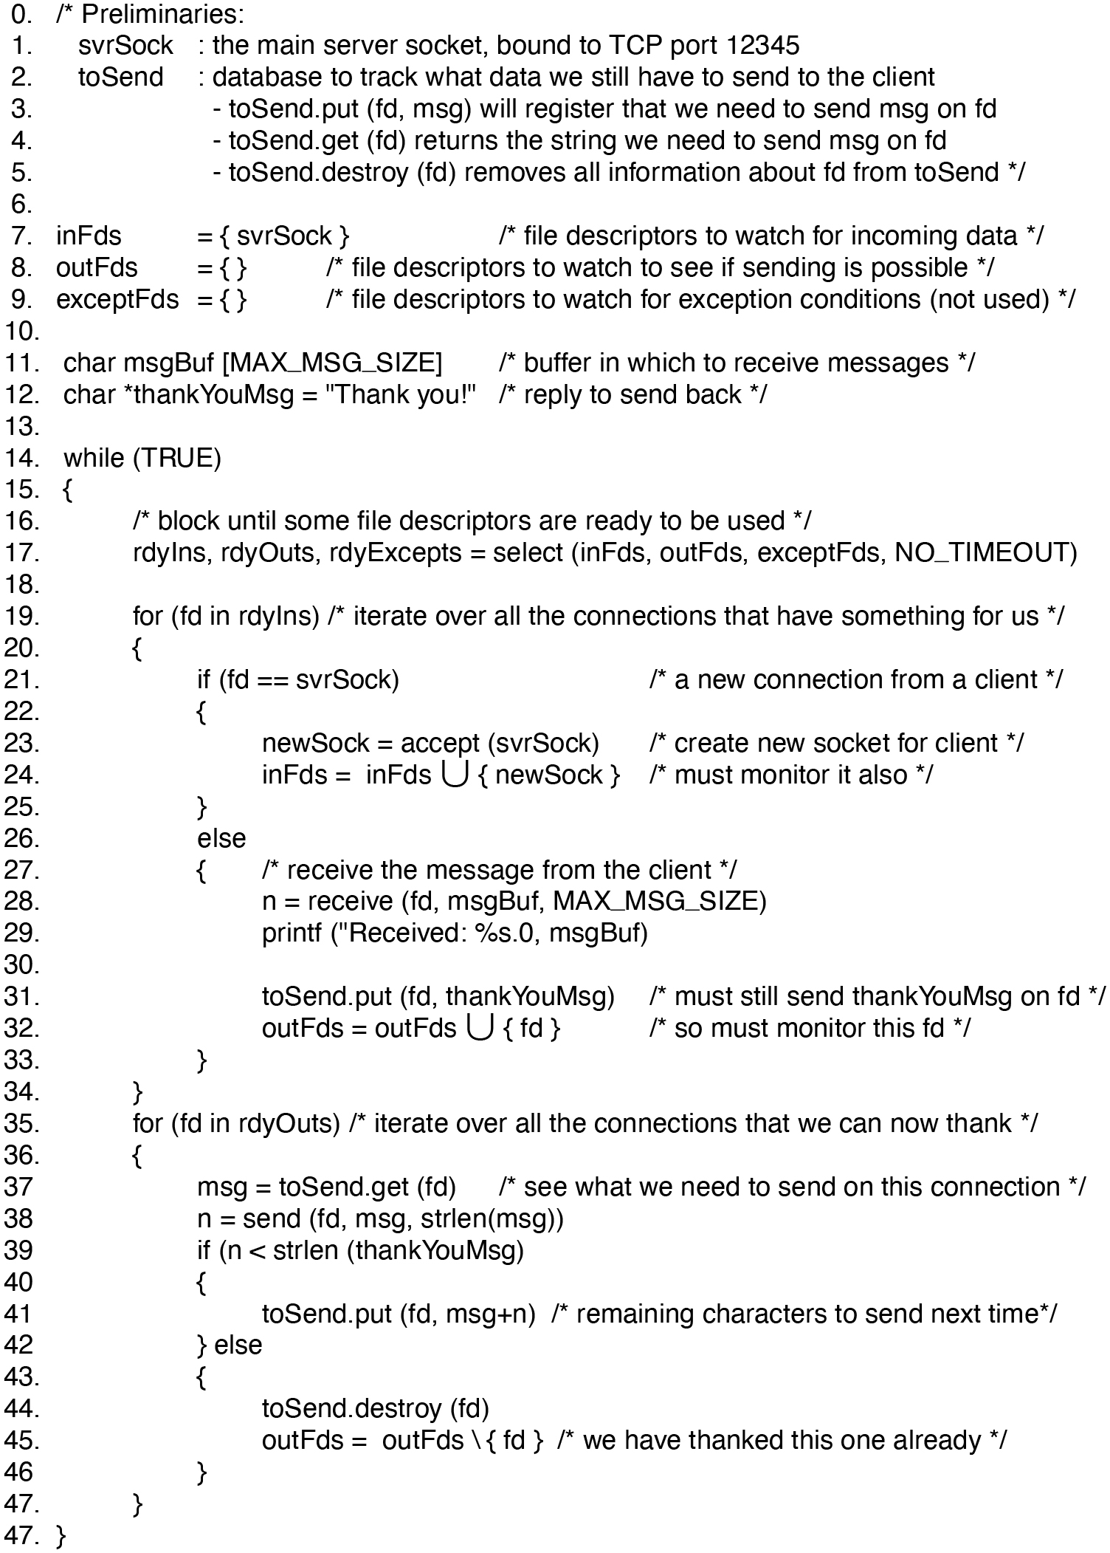
Figure 2.19
An event-driven thank-you server (pseudo code).
Notes:
Long Description:
The 49 lines of code are as follows.
0. forward slash asterisk Preliminaries colon
1. svr Sock colon the main server socket coma bound to T C P port 12345
2. to Send colon database to track what data we still have to send to the client
3. dash to Send.put open parenthesis fd coma msg close parenthesis will register that we need to send msg on fd
4. dash to Send.get open parenthesis fd close parenthesis returns the string we need to send msg on fd
5. dash to Send.destroy open parenthesis fd close parenthesis removes all information about fd from to Send asterisk forward slash
6.
7. inFds equals to open curly bracket close curly bracket forward slash asterisk file descriptors to watch for incoming data asterisk forward slash
8. outFds equals to open close curly bracket forward slash asterisk file descriptors to watch to see if sending is possible asterisk forward slash
9. exceptFds equals to open close curly bracket forward slash asterisk file descriptors to watch for exception conditions open parenthesis not used close parenthesis asterisk forward slash
10.
11. char msgBuf open box bracket MAX under score MSG under score SIZEclose box bracket forward slash asterisk buffer in which to receive messages asterisk forward slash
12. char asterisk thank You Msg equals to double quote Thank you exclamation mark double quote forward slash asterisk reply to send back asterisk forward slash
13.
14. while open parenthesis TRUE close parenthesis
15. open curly bracket
16. forward slash asterisk block until some file descriptors are ready to be used asterisk forward slash
17. rdyIns coma rdyOuts coma rdyExcepts equals to select open parenthesis inFds coma outFds coma exceptFds coma NO under score TIMEOUT close parenthesis
18.
19. for open parenthesis fd in rdylns close parenthesis forward slash asterisk iterate over all the connections that have something for us asterisk forward slash
20. open curly bracket
21. if open parenthesis fd equals to equals to close parenthesis forward slash asterisk a new connection from a client asterisk forward slash
22. open curly bracket
23. newSock equals to accept open parenthesis close parenthesis forward slash asterisk create new socket for client asterisk forward slash
24. inFds equals to inFds U open curly bracket newSock close curly bracket forward slash asterisk must monitor it also asterisk forward slash
25. close curly bracket
26. else
27. open curly bracket forward slash asterisk receive the message from the client asterisk forward slash
28. n equals to receive open parenthesis fd coma msgBuf coma MAX under score MSG under score SIZE close parenthesis
29. printf open parenthesis double quote Received colon percent s.0 coma msgBuf close parenthesis
30.
31. open parenthesis fd coma thank close parenthesis forward slash asterisk must still send thank on fd asterisk forward slash
32. outFds equals to outFds U open curly bracket fd close curly bracket forward slash asterisk so must monitor this fd asterisk forward slash
33. close curly bracket
34. close curly bracket
35. for open parenthesis fd in rdyOuts close parenthesis forward slash asterisk iterate over all the connections that we can now thank asterisk forward slash
36. open curly bracket
37. msg equals to open parenthesis fd close parenthesis forward slash asterisk see what we need to send on this connection asterisk forward slash
38. n equals to send open parenthesis fd coma msg coma strlen open parenthesis msg close parenthesis close parenthesis
39. if open parenthesis n less than strlen open parenthesis thank close parenthesis
40. open curly bracket
41. open parenthesis fd coma msg plus n close parenthesis forward slash asterisk remaining characters to send next time asterisk forward slash
42. close curly bracket else
43. open curly bracket
44. open parenthesis fd close parenthesis
45. outFds equals to outFds backward slash open curly bracket fd close curly bracket forward slash asterisk we have thanked this one already asterisk forward slash
46. close curly bracket
47. close curly bracket
47. close curly bracket

Slide 23
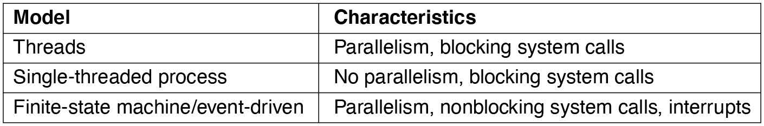
Figure 2.20
Three ways to construct a server.
Notes:
Long Description:
<html> <head> <style type="text/css"> th{ border: 1px solid black; } tr th { padding:4px; } td{ padding:4px; } </style> </head> <body> <table border="1"><tr><th>Model</th><th>Characteristics</th></tr><tr><td align="left">Threads </td><td align="left">Parallelism, blocking system calls </td></tr><tr><td align="left">Single-threaded process </td><td align="left">No parallelism, blocking system calls </td></tr><tr><td align="left">Finite-state machine/event-driven </td><td align="left">Parallelism, nonblocking system calls, interrupts </td></tr></table></body></html>

Slide 24
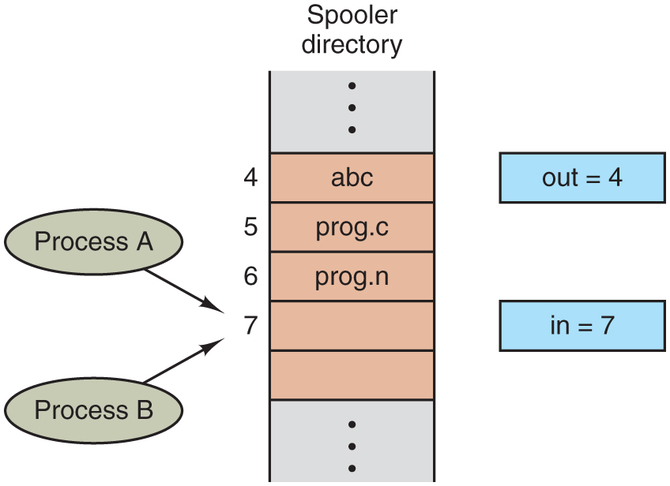
Figure 2.21
Two processes want to access shared memory at the same time.
Notes:
Long Description:
There are two vertical lines with multiple partitions labeled Spooler directory. Some partitions are labeled 4, 5, 6, and 7 from top to bottom. There are two oval-shaped blocks on the left labeled Process A and Process B with forwarding arrows pointing to the seventh partition. There are two rectangular blocks on the right labeled out equals 4 and in equals 7, respectively, from top to bottom.

Slide 25
Critical Regions
Requirements to avoid race conditions:
No two processes may be simultaneously inside their critical regions.
No assumptions may be made about speeds or the number of CPUs.
No process running outside its critical region may block other processes.
No process should have to wait forever to enter its critical region.

Slide 26
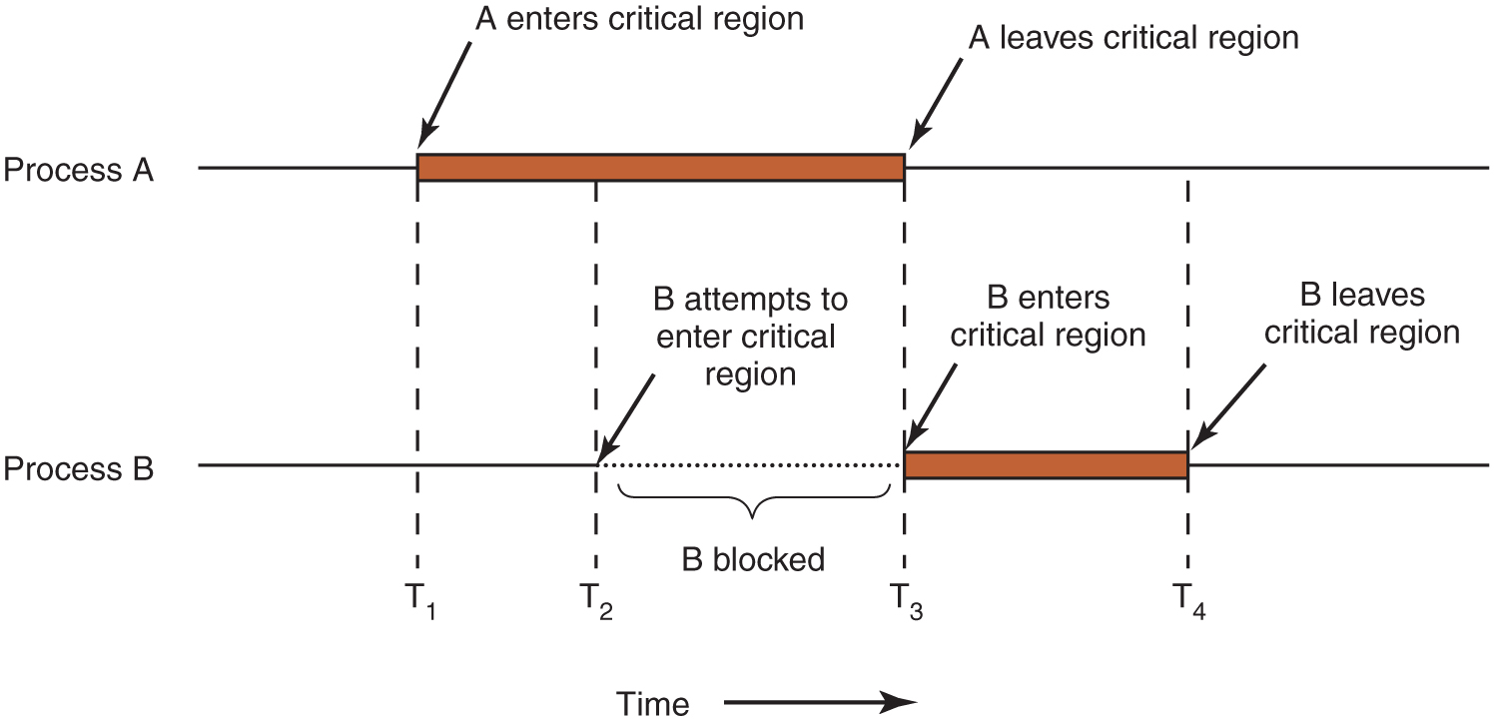
Figure 2.22
Mutual exclusion using critical regions.
Notes:
Long Description:
The horizontal direction represents time. The image consists of two parts labeled Process "A" and Process B. A straight horizontal line labeled Process "A" has a horizontal rectangular block placed on it nearly at the center. An arrow "A" enters the critical region points to the left end of the block. Another arrow labeled "A" leaves the critical region points to the right end of the block. A straight horizontal line labeled Process B has a horizontal rectangular block placed on it exactly at the point where the rectangular block of Process "A" ends. An arrow labeled B enters the critical region points to the left end of the block. Another arrow labeled B leaves the critical region points to the right end of the block. There are four time intervals labeled T1, T2, T3, and T4 from left to right. The T1 time cycle is marked from where A enters the critical region, enters process B, and exits. The T2 time cycle is marked from where the Process "A" block, attempts to enter process B, and exits. The T3 time cycle is marked from where "A" leaves the critical region, enters process B. The T4 time cycle is marked from process A end of the line enters B where B leaves the critical region. The area between T2 and T3 is labeled B attempts to enter the critical region, line of Process B at this point is a dotted line and marked as B blocked.

Slide 27
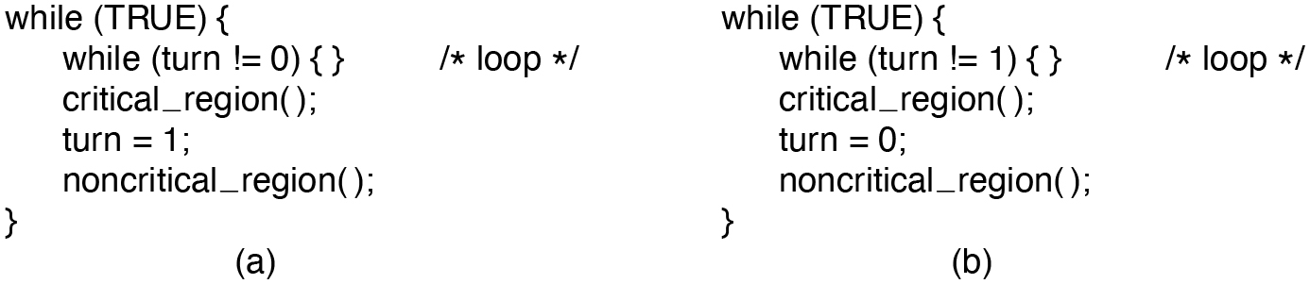
Figure 2.23
A proposed solution to the critical-region problem. (a) Process 0. (b) Process 1. In both cases, be sure to note the semicolons terminating the while statements.
Notes:
Long Description:
The 6 line of code for figure open parenthesis a close parenthesis are as follows.
while open parenthesis TRUE close parenthesis open curly bracket
while open parenthesis turn exclamation mark equals to 0 close parenthesis open close curly bracket forward slash asterisk loop asterisk forward slash
critical under score region open close parenthesis semi colon
turn equals to 1 semi colon
noncritical under score region open close parenthesis semi colon
close curly bracket
The 6 lines of code for figure open parenthesis b close parenthesis are as follow
while open parenthesis TRUE close parenthesis open curly bracket
while open parenthesis turn exclamation mark equals to 1 close parenthesis open close curly bracket forward slash asterisk loop asterisk forward slash
critical under score region open close parenthesis semi colon
turn equals to 0 semi colon
noncritical under score region open close parenthesis semi colon
close curly bracket

Slide 28
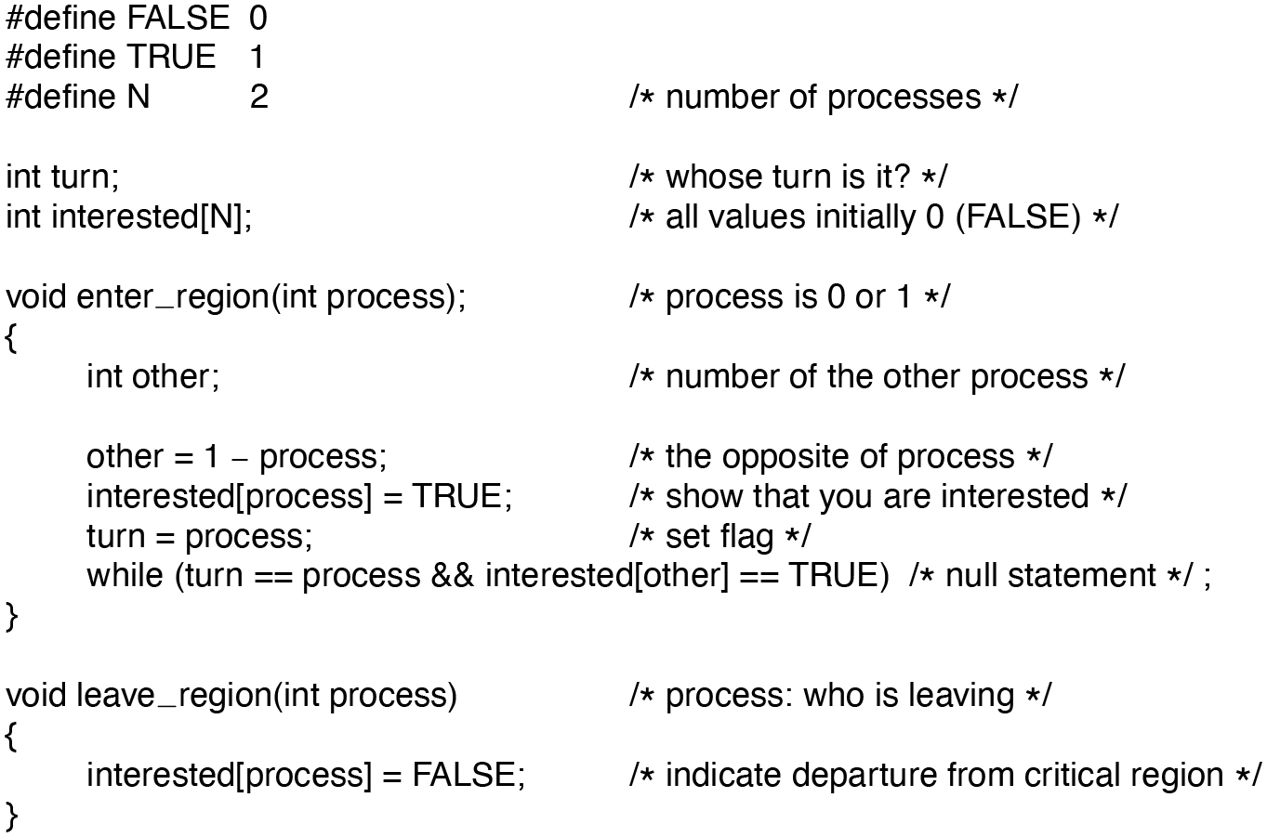
Figure 2.24
Peterson’s solution for achieving mutual exclusion.
Notes:
Long Description:
hash define FALSE 0
hash define TRUE 1
hash define N 2 forward slash asterisk number of processes asterisk forward slash
int turn semicolon forward slash asterisk whose turn is it question mark asterisk forward slash
int interested open box bracket N close box bracket semicolon forward slash asterisk all values initially 0 open parenthesis FALSE close parenthesis asterisk forward slash
void enter underscore region open parenthesis int process close parenthesis semicolon forward slash asterisk process is 0 or 1 asterisk forward slash
open curly bracket
int other semicolon forward slash asterisk number of the other process asterisk forward slash
other equals 1 minus process semicolon forward slash asterisk the opposite of process asterisk forward slash
interested open box bracket process close box bracket equals TRUE semicolon forward slash asterisk show that you are interested asterisk forward slash
turn equals process semicolon forward slash asterisk set flag asterisk forward slash
while open parenthesis turn equals equals process ampersand ampersand interested open box bracket other close box bracket equals equals TRUE close parenthesis forward slash asterisk null statement asterisk forward slash semicolon
close curly bracket
void leave underscore region open parenthesis int process close parenthesis forward slash asterisk process colon who is leaving asterisk forward slash
open curly bracket
interested open box bracket process close box bracket equals FALSE semicolon forward slash asterisk indicate departure from critical region asterisk close parenthesis
close curly bracket

Slide 29
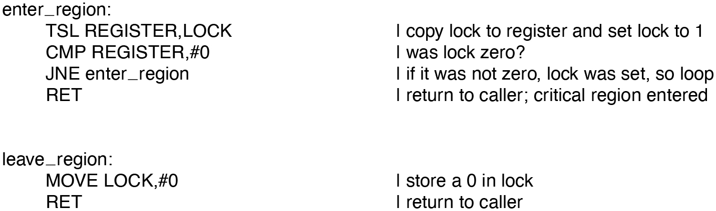
Figure 2.25
Entering and leaving a critical region using the T S L instruction.
Notes:
Long Description:
enter underscore region colon
T S L REGISTER coma LOCK vertical line copy lock to register and set lock to 1
C M P REGISTER coma hash 0 vertical line was lock zero question mark
J N E enter underscore region vertical line if it was not zero coma lock was set coma so loop
R E T vertical line return to caller semicolon critical region entered
leave underscore region colon
MOVE LOCK coma hash 0 vertical line store a 0 in lock
R E T vertical line return to caller

Slide 30
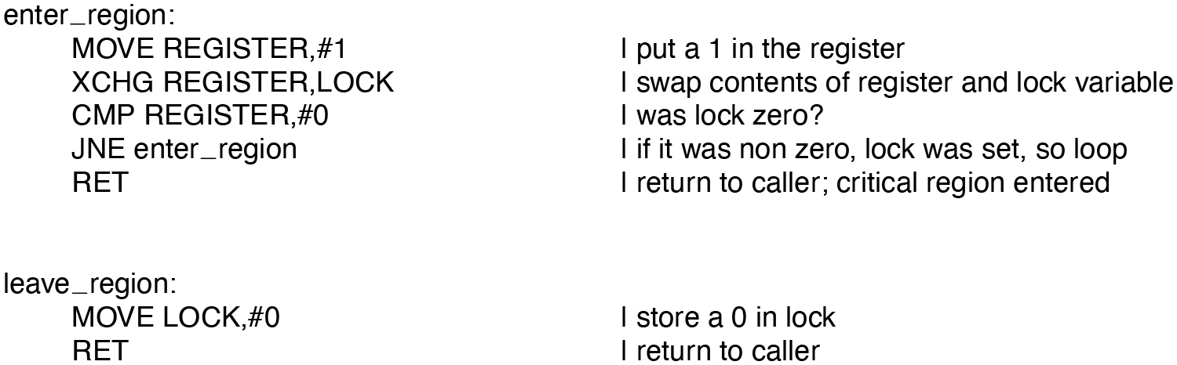
Figure 2.26
Entering and leaving a critical region using the X C H G instruction.
Notes:
Long Description:
enter underscore region colon
MOVE REGISTER coma hash 1 vertical line put a 1 in the register
X C H G REGISTER coma LOCK vertical line swap the contents of the register and lock variable
C M P REGISTER coma hash 0 vertical line was lock zero question mark
J N E enter underscore region vertical line if it was non zero coma lock was set coma so loop
R E T vertical line return to caller semicolon critical region entered
leave underscore region colon
MOVE LOCK coma hash 0 vertical line store a 0 in lock
R E T vertical line return to caller

Slide 31
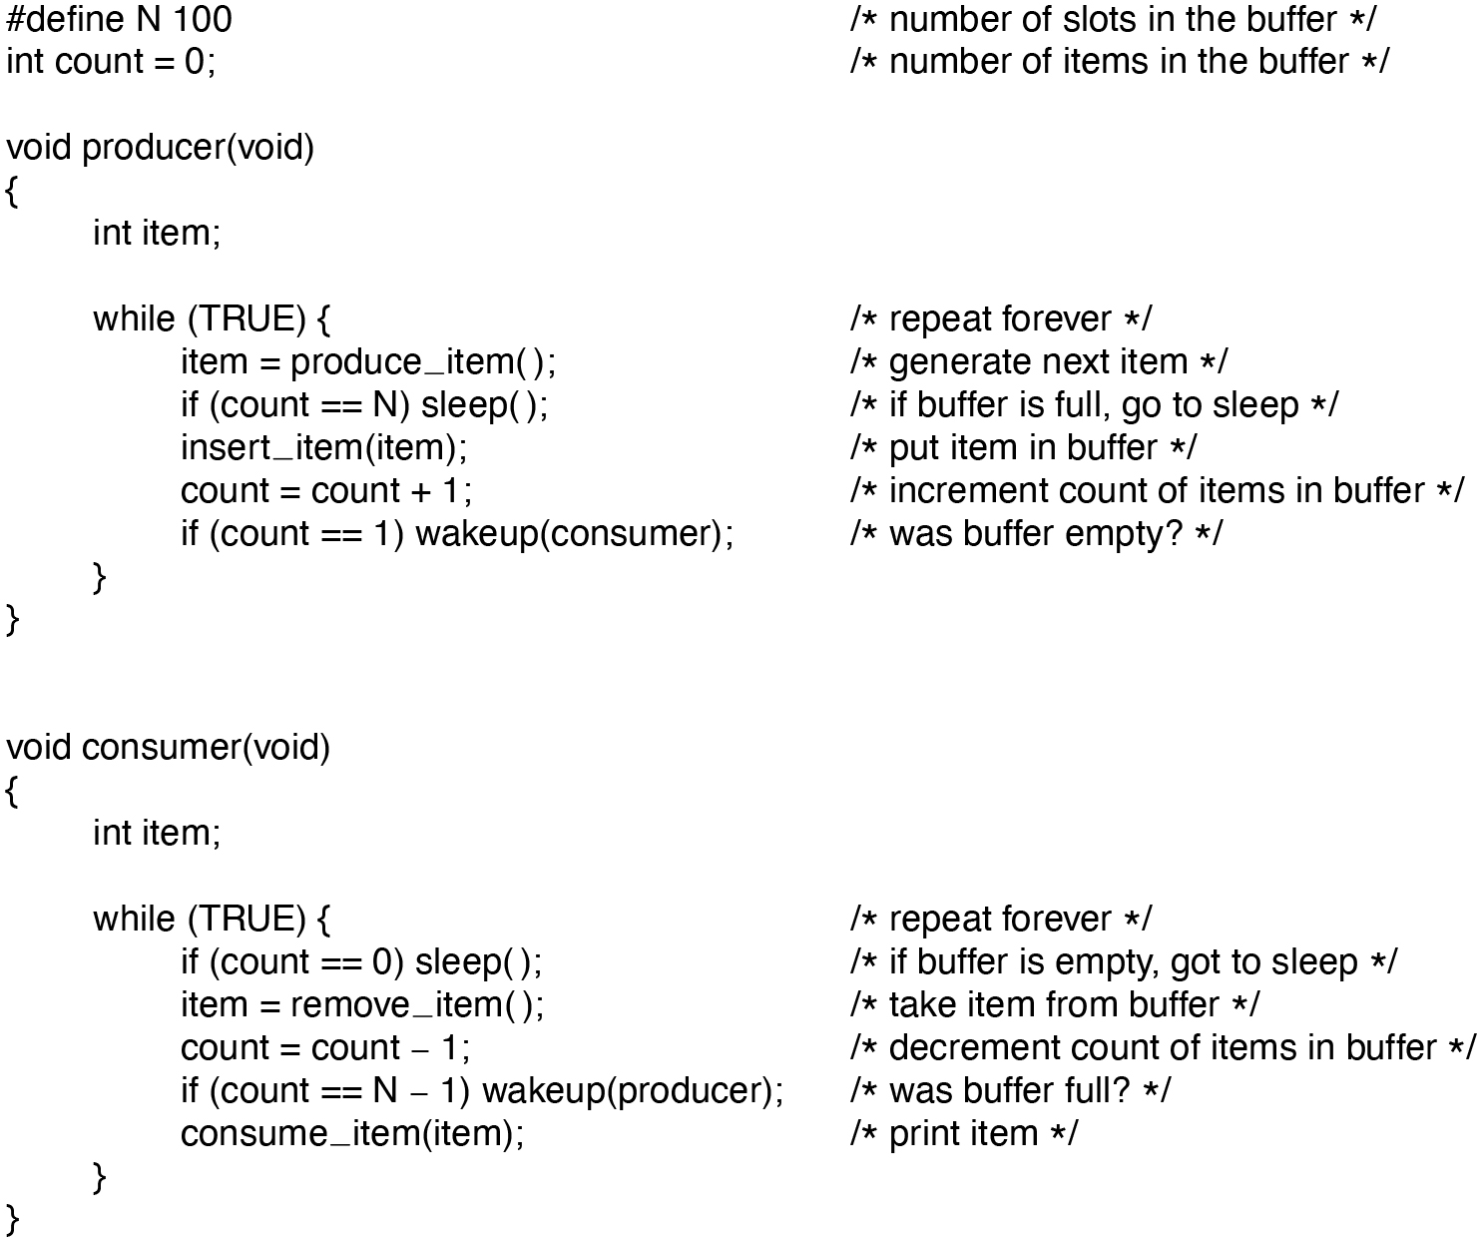
Figure 2.27
The producer-consumer problem with a fatal race condition.
Notes:
Long Description:
hash define N 100 forward slash asterisk number of slots in the buffer asterisk forward slash
int count equals 0 semicolon forward slash asterisk number of items in the buffer asterisk forward slash
void producer open parenthesis void close parenthesis
open curly bracket
int item semicolon
while open parenthesis TRUE close parenthesis open curly bracket forward slash asterisk repeat forever asterisk forward slash
item equals produce underscore item open close parenthesis semicolon forward slash asterisk generate next item asterisk forward slash
if open parenthesis count equals equals N close parenthesis sleep open close parenthesis semicolon forward slash asterisk if buffer is full coma go to sleep asterisk forward slash
insert underscore item open parenthesis item close parenthesis semicolon forward slash asterisk put item in buffer asterisk forward slash
count equals count plus 1 semicolon forward slash asterisk increment count of items in buffer asterisk forward slash
if open parenthesis count equals equals 1 close parenthesis wakeup open parenthesis consumer close parenthesis semicolon forward slash asterisk was buffer empty question mark asterisk forward slash
close curly bracket
close curly bracket
void consumer open parenthesis void close parenthesis
open curly bracket
int item semicolon
while open parenthesis TRUE close parenthesis open curly bracket forward slash asterisk repeat forever asterisk forward slash
if open parenthesis count equals equals 0 close parenthesis sleep open close parenthesis semicolon forward slash asterisk if buffer is empty coma got to sleep asterisk forward slash
item equals remove underscore item open close parenthesis semicolon forward slash asterisk take item out of buffer asterisk forward slash
count equals count minus 1 semicolon forward slash asterisk decrement count of items in buffer asterisk forward slash
if open parenthesis count equals equals N minus 1 close parenthesis wakeup open parenthesis producer close parenthesis semicolon forward slash asterisk was buffer full question mark asterisk forward slash
consume underscore item open parenthesis item close parenthesis semicolon forward slash asterisk print item asterisk forward slash
close curly bracket
close curly bracket

Slide 32
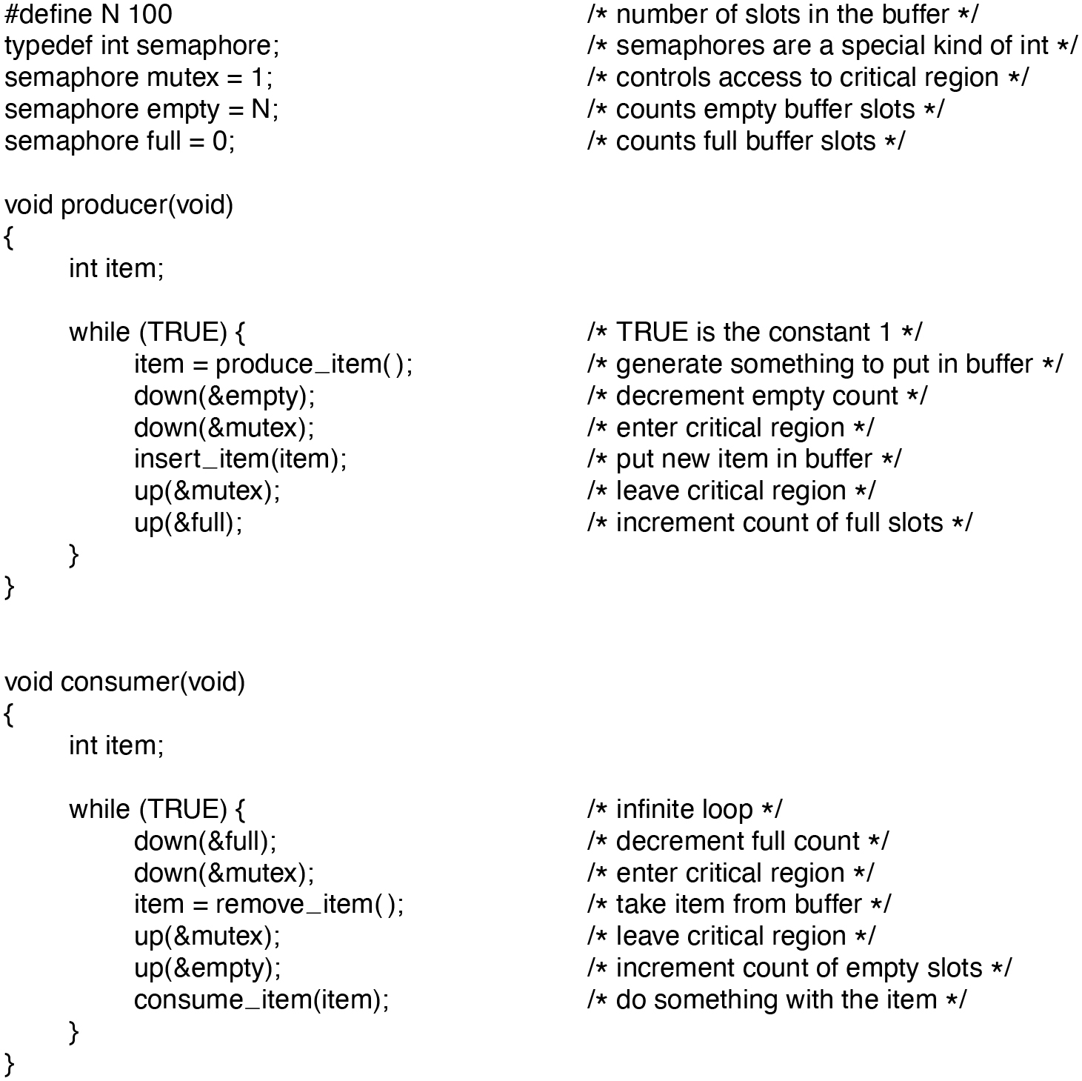
Figure 2.28
The producer-consumer problem using semaphores.
Notes:
Long Description:
hash define N 100 forward slash asterisk number of slots in the buffer asterisk forward slash
typedef int semaphore semicolon forward slash asterisk semaphores are a special kind of int asterisk forward slash
semaphore mutex equals 1 semicolon forward slash asterisk controls access to critical region asterisk forward slash
semaphore empty equals N semicolon forward slash asterisk counts empty buffer slots asterisk forward slash
semaphore full equals 0 semicolon forward slash asterisk counts full buffer slots asterisk forward slash
void producer open parenthesis void close parenthesis
open curly bracket
int item semicolon
while open parenthesis TRUE close parenthesis open curly bracket forward slash asterisk TRUE is the constant 1 asterisk forward slash
item equals produce underscore item open close parenthesis semicolon forward slash asterisk generate something to put in buffer asterisk forward slash
down open parenthesis ampersand empty close parenthesis semicolon forward slash asterisk decrement empty count asterisk forward slash
down open parenthesis ampersand mutex close parenthesis semicolon forward slash asterisk enter critical region asterisk forward slash
insert underscore item open parenthesis item close parenthesis semicolon forward slash asterisk put new item in buffer asterisk forward slash
up open parenthesis ampersand mutex close parenthesis semicolon forward slash asterisk leave critical region asterisk forward slash
up open parenthesis ampersand full close parenthesis semicolon forward slash asterisk increment count of full slots asterisk forward slash
void consumer open parenthesis void close parenthesis
open curly bracket
int item semicolon
while open parenthesis TRUE close parenthesis open curly bracket forward slash asterisk infinite loop asterisk forward slash
down open parenthesis ampersand full close parenthesis semicolon forward slash asterisk decrement full count asterisk forward slash
down open parenthesis ampersand mutex close parenthesis semicolon forward slash asterisk enter critical region asterisk forward slash
item equals remove underscore item open close parenthesis semicolon forward slash asterisk take item from buffer asterisk forward slash
up open parenthesis ampersand mutex close parenthesis semicolon forward slash asterisk leave critical region asterisk forward slash
up open parenthesis ampersand empty close parenthesis semicolon forward slash asterisk increment count of empty slots asterisk forward slash
consume underscore item open parenthesis item close parenthesis semicolon forward slash asterisk do something with the item asterisk forward slash

Slide 33
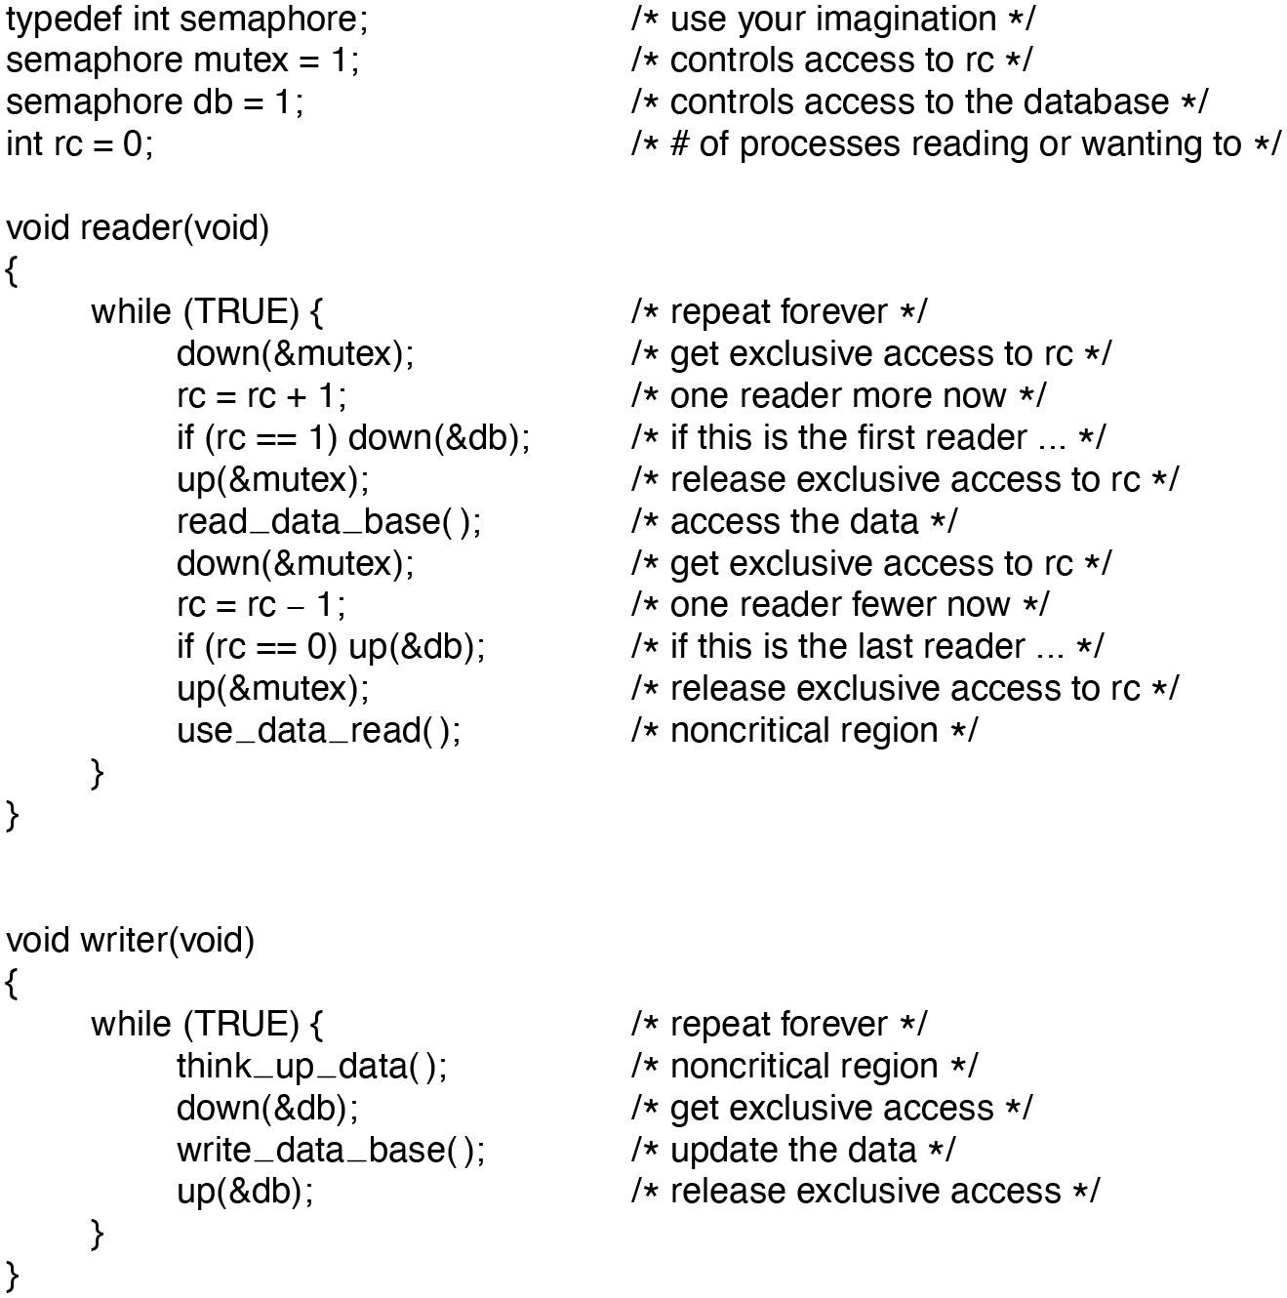
Figure 2.29
A solution to the readers and writers problem.
Notes:
Long Description:
typedef int semaphore semicolon forward slash asterisk use your imagination asterisk forward slash
semaphore mutex equals 1 semicolon forward slash asterisk controls access to r c asterisk forward slash
semaphore d b equals 1 semicolon forward slash asterisk controls access to the database asterisk forward slash
int r c equals 0 semicolon forward slash asterisk hash of processes reading or wanting to asterisk forward slash
void reader open parenthesis void close parenthesis
while open parenthesis TRUE close parenthesis open curly bracket forward slash asterisk repeat forever asterisk forward slash
down open parenthesis ampersand mutex close parenthesis semicolon forward slash asterisk get exclusive access to r c asterisk forward slash
r c equals r c plus 1 semicolon forward slash asterisk one reader more now asterisk forward slash
if open parenthesis r c equals equals 1 close parenthesis down open parenthesis ampersand d b close parenthesis semicolon forward slash asterisk if this is the first reader ... asterisk forward slash
up open parenthesis ampersand mutex close parenthesis semicolon forward slash asterisk release exclusive access to r c asterisk forward slash
read underscore data underscore base open parenthesis close parenthesis semicolon forward slash asterisk access the data asterisk forward slash
down open parenthesis ampersand mutex close parenthesis semicolon forward slash asterisk get exclusive access to r c asterisk forward slash
r c equals r c minus 1 semicolon forward slash asterisk one reader fewer now asterisk forward slash
if open parenthesis r c equals equals 0 close parenthesis up open parenthesis ampersand d b close parenthesis semicolon forward slash asterisk if this is the last reader ... asterisk forward slash
up open parenthesis ampersand mutex close parenthesis semicolon forward slash asterisk release exclusive access to r c asterisk forward slash
use underscore data underscore read open close parenthesis semicolon forward slash asterisk noncritical region asterisk forward slash
void writer open parenthesis void close parenthesis
open curly bracket
while open parenthesis TRUE close parenthesis open curly bracket forward slash asterisk repeat forever asterisk forward slash
think underscore up underscore data open close parenthesis semicolon forward slash asterisk noncritical region asterisk forward slash
down open parenthesis ampersand d b close parenthesis semicolon forward slash asterisk get exclusive access asterisk forward slash
write underscore data underscore base open close parenthesis semicolon forward slash asterisk update the data asterisk forward slash
up open parenthesis ampersand d b close parenthesis semicolon forward slash asterisk release exclusive access asterisk forward slash
close curly bracket
close curly bracket

Slide 34
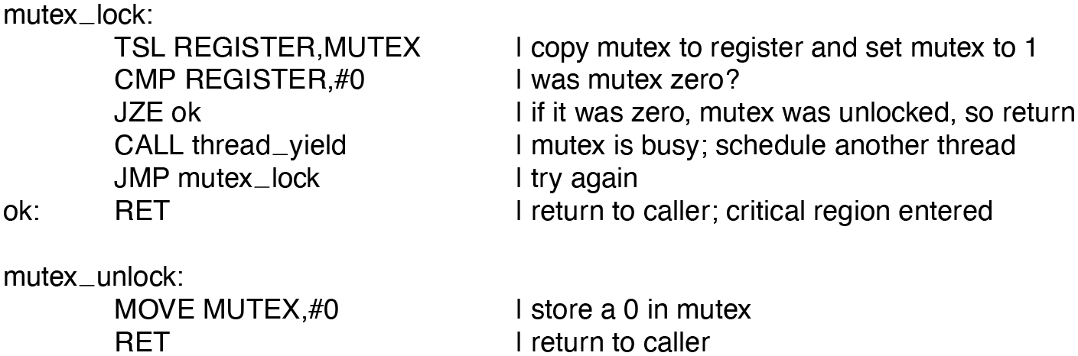
Figure 2.30
Implementation of mutex lock and mutex unlock.
Notes:
Long Description:
mutex underscore lock colon
T S L REGISTER coma MUTEX vertical line copy mutex to register and set mutex to 1
C M P REGISTER coma hash 0 vertical line was mutex zero question mark
J Z E ok vertical line if it was zero coma mutex was unlocked coma so return
CALL thread underscore yield vertical line mutex is busy semicolon schedule another thread
J M P mutex underscore lock vertical line try again
ok colon R E T vertical line return to caller semicolon critical region entered
mutex underscore unlock colon
MOVE MUTEX coma hash 0 vertical line store a 0 in mutex
R E T vertical line return to caller

Slide 35
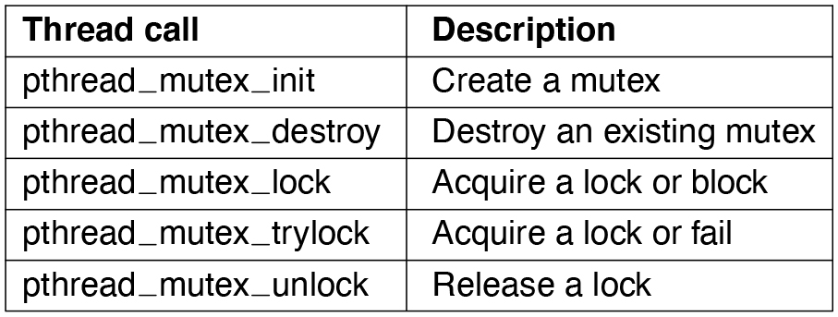
Figure 2.31
Some of the Pthreads’ calls relating to mutexes.
Notes:
Long Description:
<html> <head> <style type="text/css"> th{ border: 1px solid black; } tr th { padding:4px; } td{ padding:4px; } </style> </head> <body> <table border="1"><tr><th>Thread call</th><th>Description</th></tr><tr><td align="left">pthread_mutex_init </td><td align="left">Create a mutex </td></tr><tr><td align="left">pthread_mutex_destroy </td><td align="left">Destroy an existing mutex </td></tr><tr><td align="left">pthread_mutex_lock </td><td align="left">Acquire a lock or block </td></tr><tr><td align="left">pthread_mutex_trylock </td><td align="left">Acquire a lock or fail </td></tr><tr><td align="left">pthread_mutex_unlock </td><td align="left">Release a lock </td></tr></table></body></html>

Slide 36
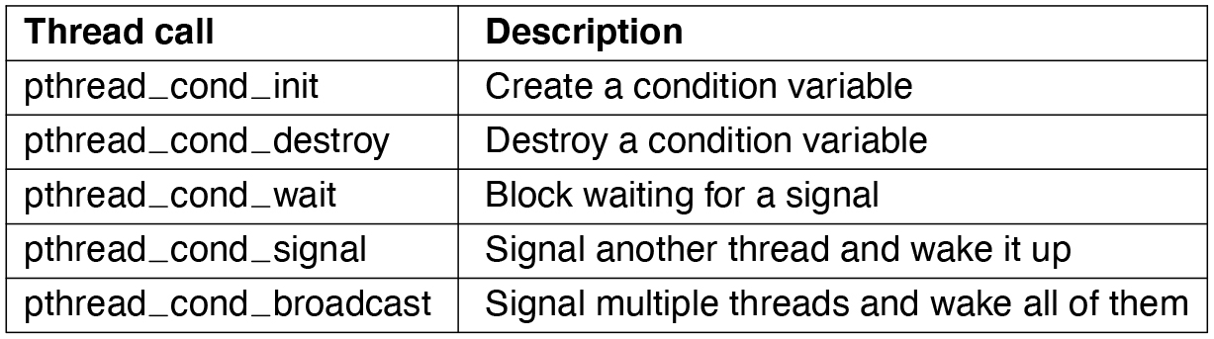
Figure 2.32
Some of the Pthreads calls relating to condition variables.
Notes:
Long Description:
<html> <head> <style type="text/css"> th{ border: 1px solid black; } tr th { padding:4px; } td{ padding:4px; } </style> </head> <body> <table border="1"><tr><th>Thread call</th><th>Description</th></tr><tr><td>pthread_cond_init </td><td>Create a condition variable </td></tr><tr><td>pthread_cond_destroy </td><td>Destroy a condition variable </td></tr><tr><td>pthread_cond_wait </td><td>Block waiting for a signal </td></tr><tr><td>pthread_cond_signal </td><td>Signal another thread and wake it up </td></tr><tr><td>pthread_cond_broadcast </td><td>Signal multiple threads and wake all of them </td></tr></table></body></html>

Slide 37
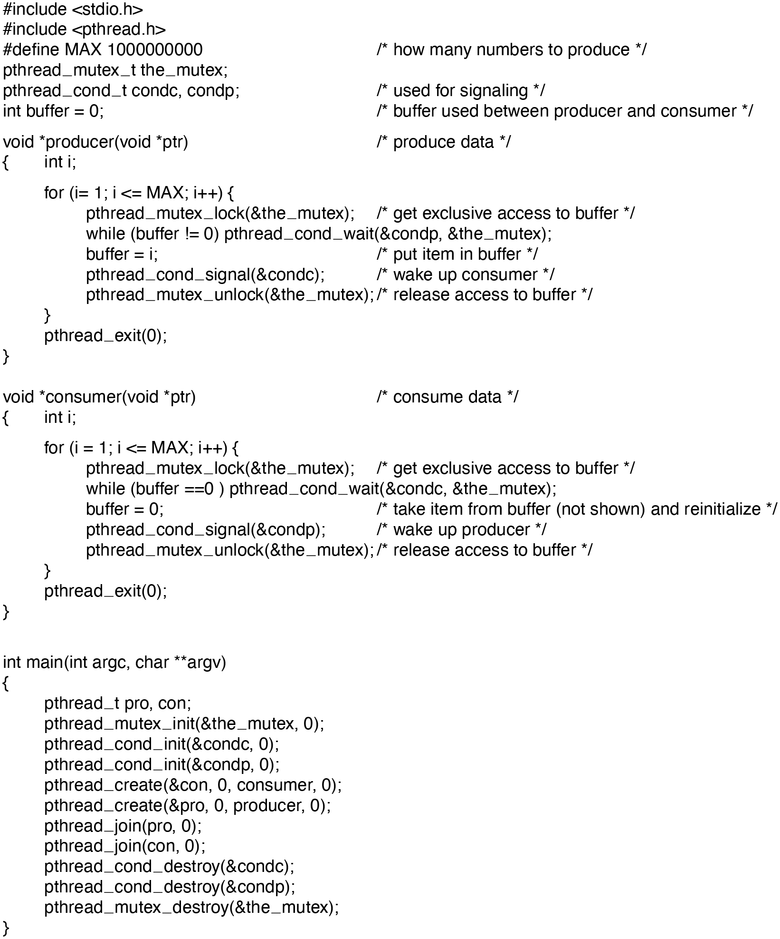
Figure 2.33
Using threads to solve the producer-consumer problem.
Notes:
Long Description:
The 43 lines of code are as follows.
hash include open angle bracket stdio.h close angle bracket
hash include open angle bracket pthread.h close angle bracket
hash define MAX 1000000000 forward slash asterisk how many numbers to produce asterisk forward slash
othread under score mutex under score t the under score mutex semi colon
othread under score cond under score t condc coma condp semi colon forward slash asterisk used for signaling asterisk forward slash
int buffer equals to 0 semi colon forward slash asterisk buffer used between producer and consumer asterisk forward slash
void asterisk producer open parenthesis void asterisk ptr close parenthesis forward slash asterisk produce data asterisk forward slash
open curly bracket
int i semi colon
for open parenthesis i equals to 1 semi colon i less than equals to MAX semi colon i plus plus close parenthesis open curly bracket
pthread under score mutex under score lock open parenthesis &the under score mutex close parenthesis semi colon forward slash asterisk get exclusive access to buffer asterisk forward slash
while open parenthesis buffer exclamation mark equals to 0 close parenthesis pthread under score cond under score wait open parenthesis &condp coma &the under score mutex close parenthesis semi colon
buffer equals to i semi colon forward slash asterisk put item in buffer asterisk forward slash
pthread under score cond under score signal open parenthesis &condc close parenthesis semi colon forward slash asterisk wake up consumer asterisk forward slash
pthread under score mutex under score unlock open parenthesis &the under score mutex close parenthesis semi colon forward slash asterisk release access to buffer asterisk forward slash
close curly bracket
pthread under score exit open parenthesis 0 close parenthesis semi colon
close curly bracket
void asterisk consumer open parenthesis void asterisk ptr close parenthesis forward slash asterisk consume data asterisk forward slash
open curly bracket int i semi colon
for open parenthesis i equals to 1 semi colon i less than equals to MAX semi colon i plus plus close parenthesis open curly bracket
pthread under score mutex under score lock open parenthesis &the under score mutex close parenthesis semi colon forward slash asterisk get exclusive access to buffer asterisk forward slash
while open parenthesis buffer equals to equals to 0 close parenthesis pthread under score cond under score wait open parenthesis &condc coma &the under score mutex close parenthesis semi colon
buffer equals to 0 semi colon forward slash asterisk take item out of buffer open parenthesis not shown close parenthesis and reinitialize asterisk forward slash
pthread under score cond under score signal open parenthesis &condp close parenthesis semi colon forward slash asterisk wake up producer asterisk forward slash
pthread under score mutex under score unlock open parenthesis &the under score mutex close parenthesis semi colon forward slash asterisk release access to buffer asterisk forward slash
close curly bracket
pthread under score exit open parenthesis 0 close parenthesis semi colon
close curly bracket
int main open parenthesis int argc coma char asterisk asterisk argv close parenthesis
open curly bracket
pthread under score t pro coma con semi colon
pthread under score mutex under score init open parenthesis &the under score mutex coma 0 close parenthesis semi colon
pthread under score cond under score init open parenthesis &condc coma 0 close parenthesis semi colon
pthread under score cond under score init open parenthesis &condp coma 0 close parenthesis semi colon
pthread under score create open parenthesis &con coma 0 coma consumer coma 0 close parenthesis semi colon
pthread under score create open parenthesis &pro coma 0 coma producer coma 0 close parenthesis semi colon
pthread under score join open parenthesis pro coma 0 close parenthesis semi colon
pthread under score join open parenthesis con coma 0 close parenthesis semi colon
pthread under score cond under score destroy open parenthesis &condc close parenthesis semi colon
pthread under score cond under score destroy open parenthesis &condp close parenthesis semi colon
pthread under score mutex under score destroy open parenthesis &the under score mutex close parenthesis semi colon
close curly bracket

Slide 38
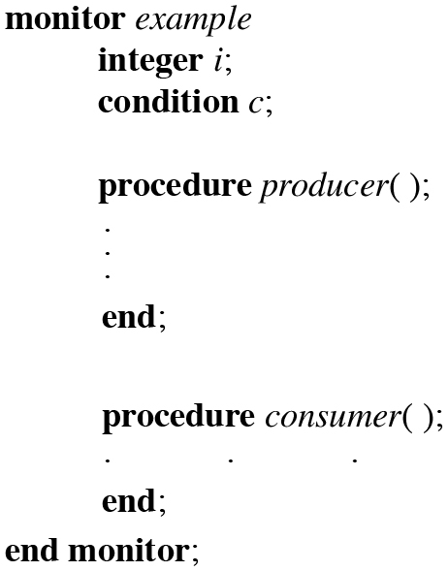
Figure 2.34
A monitor.
Notes:
Long Description:
The coding structure for the example monitor ar as follows.
monitor example
integer i semi colon
condition c semi colon
procedure producer open close parenthesis semi colon
.
.
.
end semi colon
procedure consumer open close parenthesis colon
. . .
end semi colon
end monitor semi colon

Slide 39
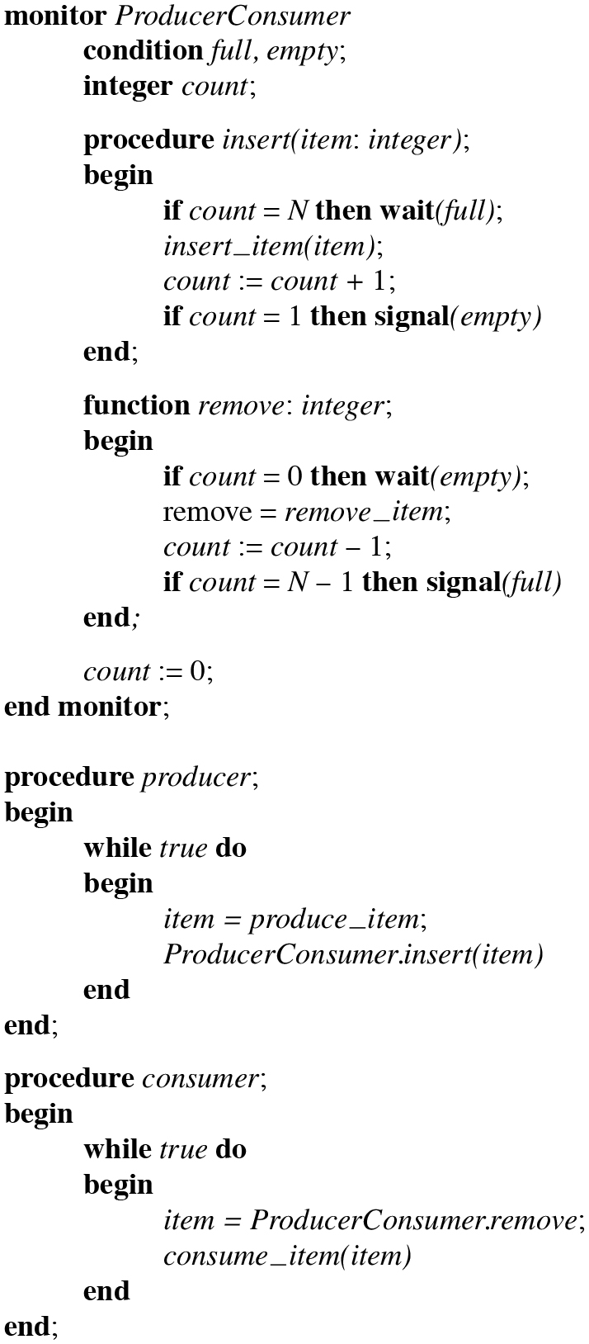
Figure 2.35
An outline of the producer-consumer problem with monitors. Only one monitor procedure at a time is active. The buffer has N slots.
Notes:
Long Description:
The 35 lines of code are as follows.
monitor ProducerConsumer
condition full coma empty semi colon
integer count semi colon
procedure insert open parenthesis item colon integer close parenthesis semi colon
begin
if count equals to N then wait open parenthesis full close parenthesis semi colon
insert under score item open parenthesis item close parenthesis semi colon
count colon equals to count plus 1 semi colon
if count equals to 1 then signal open parenthesis empty close parenthesis
end semi colon
function remove colon integer semi colon
begin
if count equals to 0 then wait open parenthesis empty close parenthesis semi colon
remove equals to remove under score item semi colon
count colon equals to count minus 1 semi colon
if count equals to N minus 1 then signal open parenthesis full close parenthesis
end semi colon
count colon equals to 0 semi colon
end monitor semi colon
procedure producer semi colon
begin
while true do
begin
item equals to produce under score item semi colon
ProducerConsumer.insert open parenthesis item close parenthesis
end
end semi colon
procedure consumer semi colon
begin
while true do
begin
item equals to ProducerConsumer.remove semi colon
consume under score item open parenthesis item close parenthesis
end
end semi colon

Slide 40
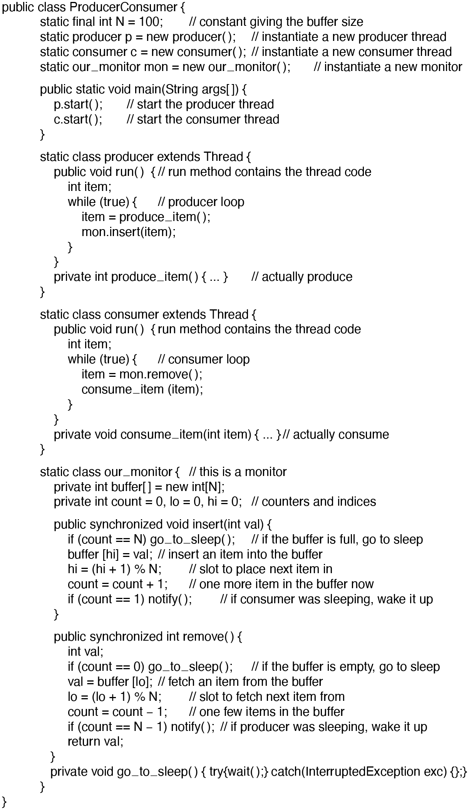
Figure 2.36
A solution to the producer-consumer problem in Java.
Notes:
Long Description:
The 52 lines of code are as follows.
public class ProducerConsumer open curly bracket
static final int N equals to 100 semi colon forward slash forward slash constant giving the buffer size
static producer p equals to new producer open close parenthesis semi colon forward slash forward slash instantiate a new producer thread
static consumer c equals to new consumer open close parenthesis semi colon forward slash forward slash instantiate a new consumer thread
static our under score monitor mon equals to new our under score monitor open close parenthesis semi colon forward slash forward slash instantiate a new monitor
public static void main open parenthesis String argsopen close box bracket close parenthesis open curly bracket
p.start open close parenthesis semi colon forward slash forward slash start the producer thread
c.start open close parenthesis semi colon forward slash forward slash start the consumer thread
close curly bracket
static class producer extends Thread open curly bracket
public void run open close parenthesis open curly bracket forward slash forward slash run method contains the thread code
int item semi colon
while open parenthesis true close parenthesis open curly bracket forward slash forward slash producer loop
item equals to produce under score item open close parenthesis semi colon
mon.insert open parenthesis item close parenthesis semi colon
close curly bracket
close curly bracket
private int produce under score item open close parenthesis open curly bracket ... close curly bracket forward slash forward slash actually produce
close curly bracket
static class consumer extends Thread open curly bracket
public void run open close parenthesis open curly bracket run method contains the thread code
int item semi colon
while open parenthesis true close parenthesis open curly bracket
forward slash forward slash consumer loop
item equals to mon.remove open close parenthesis semi colon
consume under score item open parenthesis item close parenthesis semi colon
close curly bracket
close curly bracket
private void consume under score item open parenthesis int item close parenthesis open curly bracket ... close curly bracket forward slash forward slash actually consume
close curly bracket
static class our under score monitor open curly bracket forward slash forward slash this is a monitor
private int buffer open close box bracket equals to new intopen box bracket Nclose box bracket semi colon
private int count equals to 0 coma lo equals to 0 coma hi equals to 0 semi colon forward slash forward slash counters and indices
public synchronized void insert open parenthesis int val close parenthesis open curly bracket
if open parenthesis count equals to equals to N close parenthesis go under score to under score sleep open close parenthesis semi colon forward slash forward slash if the buffer is full coma go to sleep
buffer open box bracket hiclose box bracket equals to val semi colon forward slash forward slash insert an item into the buffer
hi equals to open parenthesis hi plus 1 close parenthesis percent N semi colon forward slash forward slash slot to place next item in
count equals to count plus 1 semi colon forward slash forward slash one more item in the buffer now
if open parenthesis count equals to equals to 1 close parenthesis notify open close parenthesis semi colon forward slash forward slash if consumer was sleeping coma wake it up
close curly bracket
public synchronized int remove open close parenthesis open curly bracket
int val semi colon
if open parenthesis count equals to equals to 0 close parenthesis go under score to under score sleep open close parenthesis semi colon forward slash forward slash if the buffer is empty coma go to sleep
val equals to buffer open box bracket loclose box bracket semi colon forward slash forward slash fetch an item from the buffer
lo equals to open parenthesis lo plus 1 close parenthesis percent N semi colon forward slash forward slash slot to fetch next item from
count equals to count minus 1 semi colon forward slash forward slash one few items in the buffer
if open parenthesis count equals to equals to N minus 1 close parenthesis notify open close parenthesis semi colon forward slash forward slash if producer was sleeping coma wake it up
return val semi colon
close curly bracket
private void go under score to under score sleep open close parenthesis open curly bracket try open curly bracket wait open close parenthesis semi colon close curly bracket catch open parenthesis Interrupted Exception exec close parenthesis open close curly bracket semi colon close curly bracket
close curly bracket
close curly bracket

Slide 41
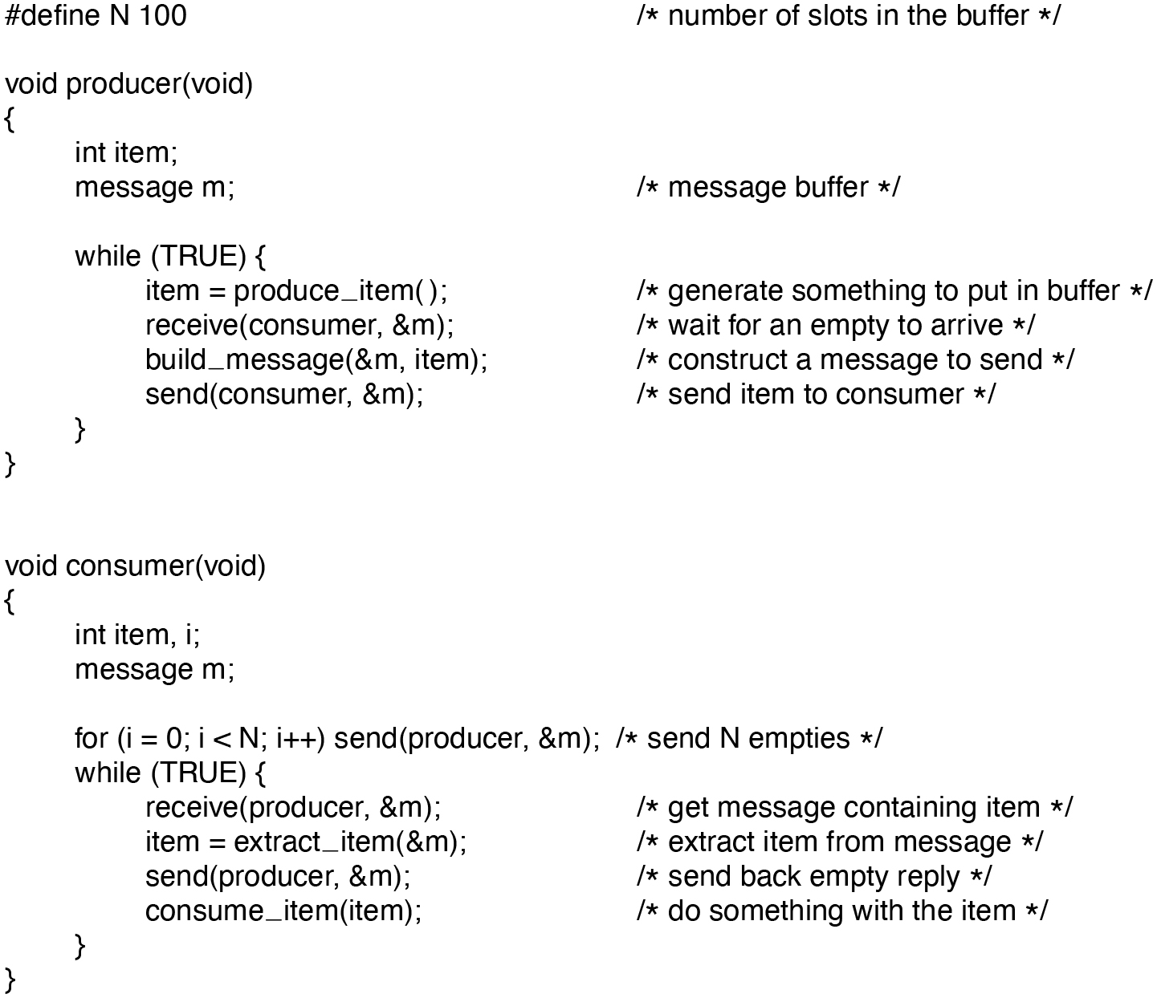
Figure 2.37
The producer-consumer problem with N messages.
Notes:
Long Description:
The 24 lines of code are as follows.
hash define N 100 forward slash asterisk number of slots in the buffer asterisk forward slash
void producer open parenthesis void close parenthesis
open curly bracket
int item semi colon
message m semi colon forward slash asterisk message buffer asterisk forward slash
while open parenthesis TRUE close parenthesis open curly bracket
item equals to produce under score item open close parenthesis semi colon forward slash asterisk generate something to put in buffer asterisk forward slash
receive open parenthesis consumer coma &m close parenthesis semi colon forward slash asterisk wait for an empty to arrive asterisk forward slash
build under score message open parenthesis &m coma item close parenthesis semi colon forward slash asterisk construct a message to send asterisk forward slash
send open parenthesis consumer coma &m close parenthesis semi colon forward slash asterisk send item to consumer asterisk forward slash
close curly bracket
close curly bracket
void consumer open parenthesis void close parenthesis
open curly bracket
int item coma i semi colon
message m semi colon
for open parenthesis i equals to 0 semi colon i less than N semi colon i plus plus close parenthesis send open parenthesis producer coma &m close parenthesis semi colon forward slash asterisk send N empties asterisk forward slash
while open parenthesis TRUE close parenthesis open curly bracket
receive open parenthesis producer coma &m close parenthesis semi colon forward slash asterisk get message containing item asterisk forward slash
item equals to extract under score item open parenthesis &m close parenthesis semi colon forward slash asterisk extract item from message asterisk forward slash
send open parenthesis producer coma &m close parenthesis semi colon forward slash asterisk send back empty reply asterisk forward slash
consume under score item open parenthesis item close parenthesis semi colon forward slash asterisk do something with the item asterisk forward slash
close curly bracket
close curly bracket

Slide 42
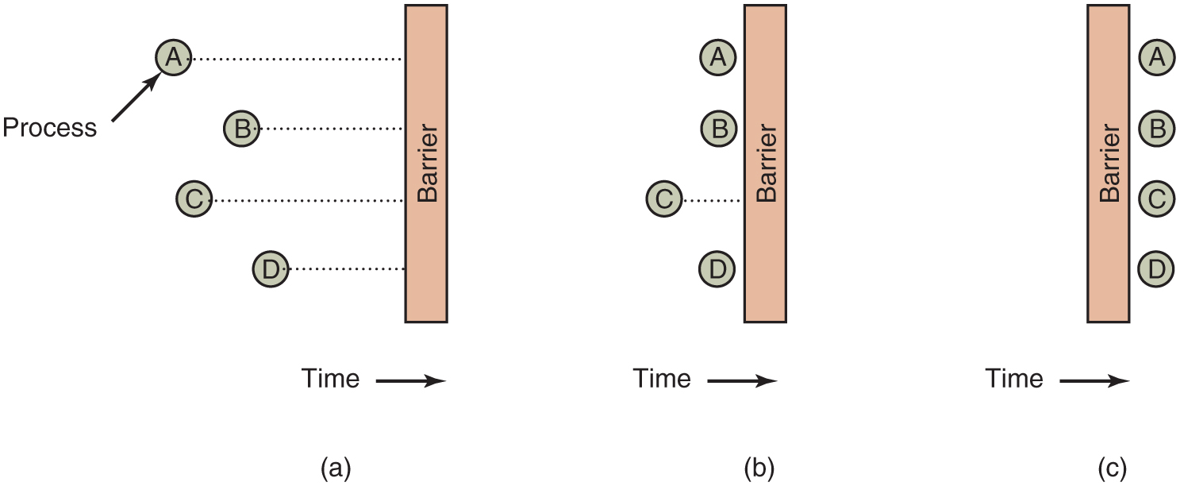
Figure 2.38
Use of a barrier. (a) Processes approaching a barrier. (b) All processes but one blocked at the barrier. (c) When the last process arrives at the barrier, all of them are let through.
Notes:
Long Description:
In all three parts, the horizontal axis represents time. An arrow labeled Time is placed below all three parts. Part (a): A vertical rectangular block is labeled Barrier. There are four processes labeled A, B, C, and D placed from top to bottom on the left of the block and connected to the barrier with dotted lines. Process "A" has the most dotted lines, C has lesser dotted lines than A, B has lesser dotted lines than C, and D has the least dotted lines. Part (b): A vertical rectangular block is labeled Barrier. There are four processes labeled A, B, C, and D placed from top to bottom on the left of the block. "A", B, and D are placed on the left edge of the block but the C process is connected with the Barrier with the dotted line. Part (c): A vertical rectangular block is labeled Barrier and Time with a forward arrow at the bottom. There are four processes labeled A, B, C, and D placed on the right edge of the block from top to bottom.

Slide 43
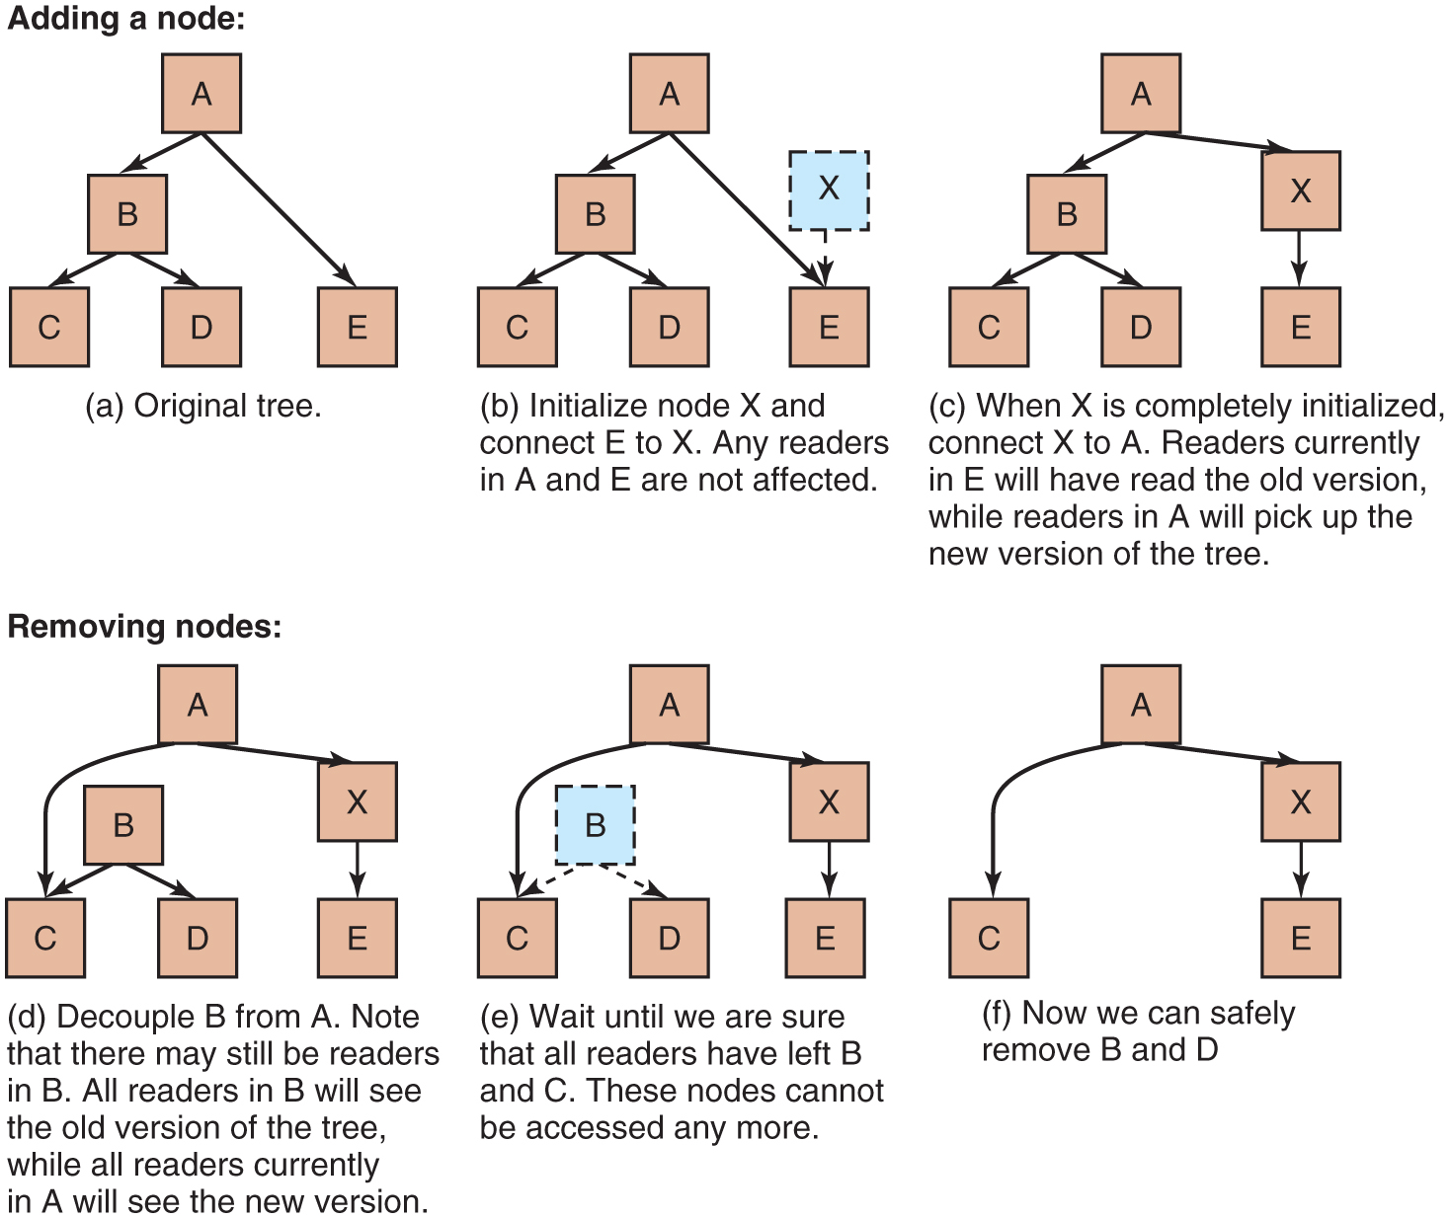
Figure 2.39
Read-Copy-Update: inserting a node in the tree and then removing a branch—all without locks.
Notes:
Long Description:
Part (a): It is labeled Original tree. The tree starts at Adding a node. A has two possibilities B and E. B has two possibilities C and D. Part (b): It is labeled initialize node X and connect E to X. Any readers in A and E are not affected. The tree is the same as in part (a). Only node X is added at the top of node E in a dashed square box and a dashed downward arrow connected to node E. Part (c): It is labeled When X is completely initialized, connect X to A. Readers currently in E will have read the old version, while readers in A will pick up the new version of the tree. In this part, the tree is the same as in part (b). Only, node A is connected to node X and node X is connected to node E. Also, node X is in a normal squared box, not a dashed line box. Part (d): It is labeled as Decouple B from A. Note that there may still be readers in B. All readers in B will see the old version of the tree, while all readers currently in A will see the new version. The tree is the same as in part (c). Only, there is a bidirectional arrow from node C to node X. Part (e): It is labeled as Wait until we are sure that all readers have left B and C. These nodes cannot be accessed anymore. The tree is the same as in part (d). Only, node B is now in a dashed box with dashed connected arrows. Part (f): It is labeled as Now we can safely remove B and D. Now, finally in a tree, A has two possibilities C and X. X has one possibility E.

Slide 44
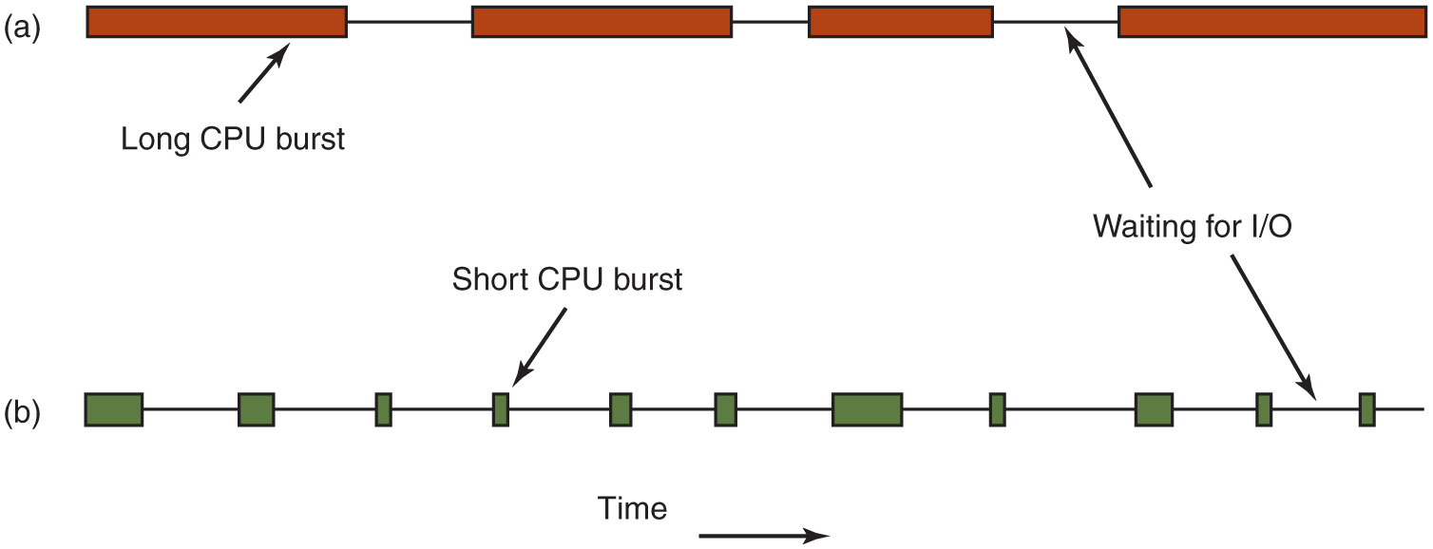
Figure 2.40
Bursts of C P U usage alternate with periods of waiting for I/O. (a) A C P U-bound process. (b) An I/O-bound process.
Notes:
Long Description:
Part (a): There are four horizontal rectangular blocks connected with each other where the first and last are not connected. The first block is labeled Long C P U burst. The third block is the smallest. Part (b): There are eleven rectangular blocks of different sizes. The Time is denoted by a forward arrow at the bottom. The fourth block with an arrow on top is labeled Short C P U burst. There is a bidirectional arrow between the tenth and eleventh blocks labeled Waiting for I/O points between a third and fourth block of part (a).

Slide 45
Categories of Scheduling Algorithms
Batch.
Interactive.
Real time.

Slide 46
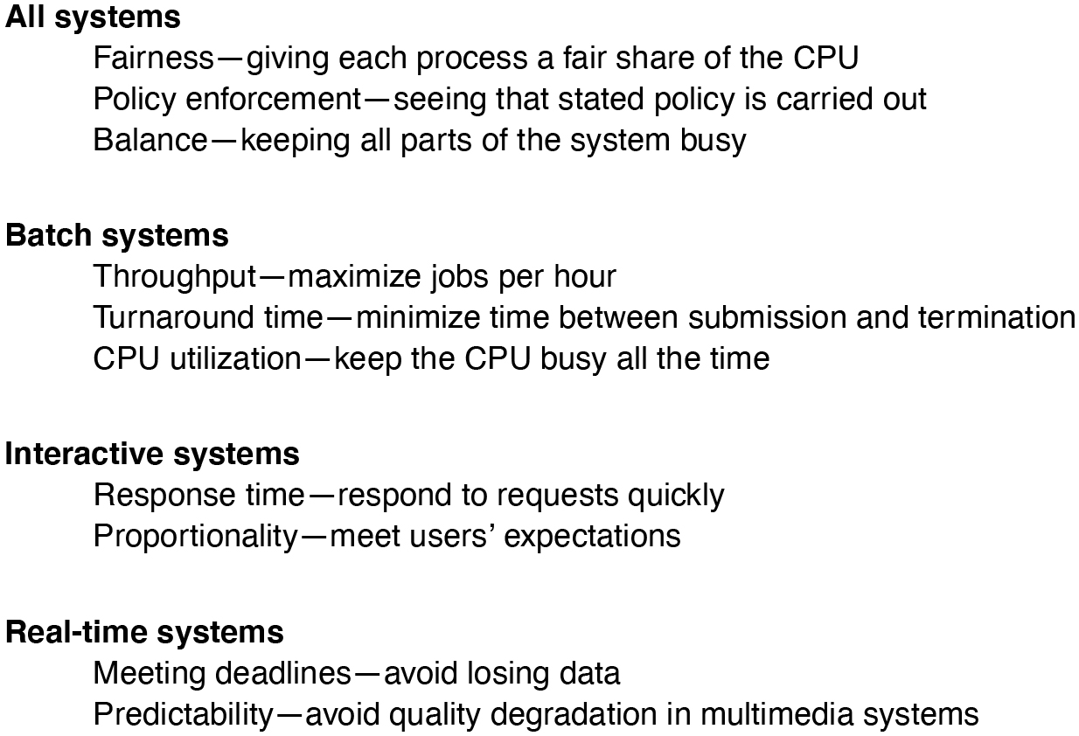
Figure 2.41
Some goals of the scheduling algorithm under different circumstances.
Notes:
Long Description:
The statements for the four different systems are as follows.
All systems
Fairness dash giving each process a fair share of the C P U
Policy enforcement dash seeing that stated policy is carried out
Balance dash keeping all parts of the system busy
Batch systems
Throughput dash maximize jobs per hour
Turnaround time dash minimize time between submission and termination
C P U utilization dash keep the C P U busy all the time
Interactive systems
Response time dash respond to requests quickly
Proportionality dash meet users' expectations
Real dash time systems
Meeting deadlines dash avoid losing data
Predictability dash avoid quality degradation in multimedia systems

Slide 47
Scheduling in Batch Systems
First-Come First-Served
Shortest Job First
Shortest Remaining Time Next

Slide 48
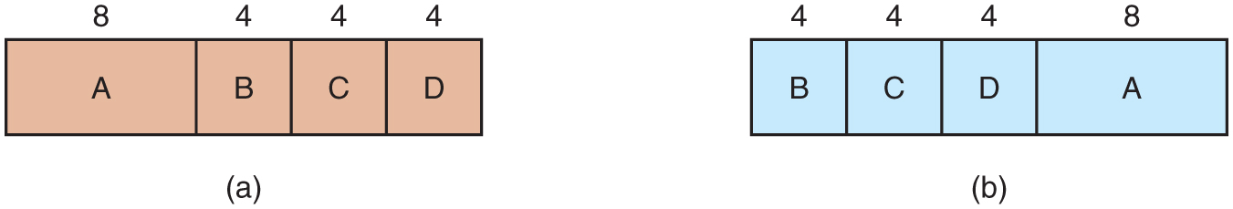
Figure 2.42
An example of shortest-job-first scheduling. (a) Running four jobs in the original order. (b) Running them in shortest-job-first order.
Notes:
Long Description:
Part (a): A horizontal rectangular block has four partitions labeled A, B, C, and D from left to right. All four partitions are marked with values 8, 4, 4, and 4 from left to right. Part (b): A horizontal rectangular block has four partitions labeled B, C, D, and A from left to right. All four partitions are marked with values 4, 4, 4, and 8 from left to right.

Slide 49
Scheduling in Interactive Systems
Round-Robin Scheduling
Priority Scheduling
Multiple Queues
Shortest Process Next
Guaranteed Scheduling
Lottery Scheduling
Fair-Share Scheduling

Slide 50
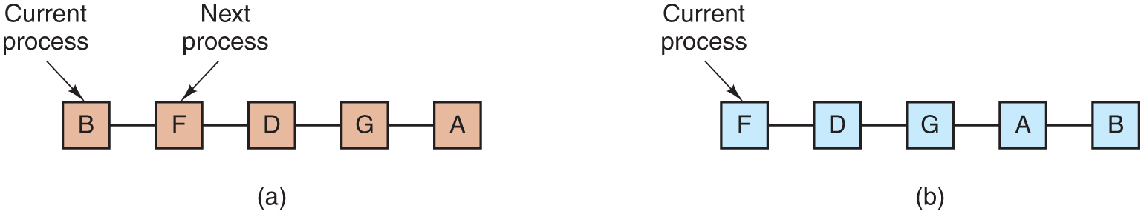
Figure 2.43
Round-robin scheduling. (a) The list of runnable processes. (b) The list of runnable processes after B uses up its quantum.
Notes:
Long Description:
Part (a): Five square blocks are connected with each other horizontally where the first and last blocks are not connected. The five blocks are labeled B, F, D, G, and A from left to right. The B block is labeled Current process and the F block is labeled Next process. Part (b): Five square blocks are connected with each other horizontally where the first and last blocks are not connected. The five blocks are labeled F, D, G, A, and B from left to right. The F block is labeled Current process.

Slide 51
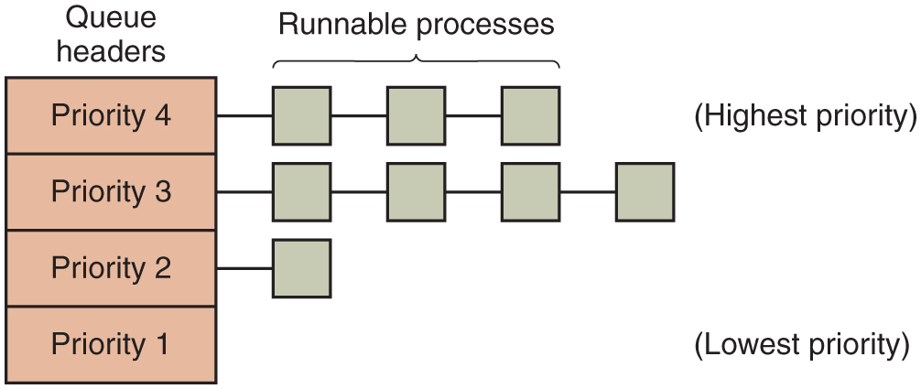
Figure 2.44
A scheduling algorithm with four priority classes.
Notes:
Long Description:
A vertical rectangular block is labeled Queue Headers and has four partitions from top to bottom labeled Priority 4, Priority 3, Priority 2, and Priority 1. There are Runnable processes connected with each partition. Priority 4 has three horizontal blocks connected with Highest Priority. Priority 3 has four horizontal blocks connected. Priority 2 has one horizontal block connected. Priority 1 has no block connected and is labeled with Lowest Priority.

Slide 52
Scheduling in Real-Time Systems
Time plays an essential role
Categories
Hard real time
Soft real time
Periodic or aperiodic

Slide 53
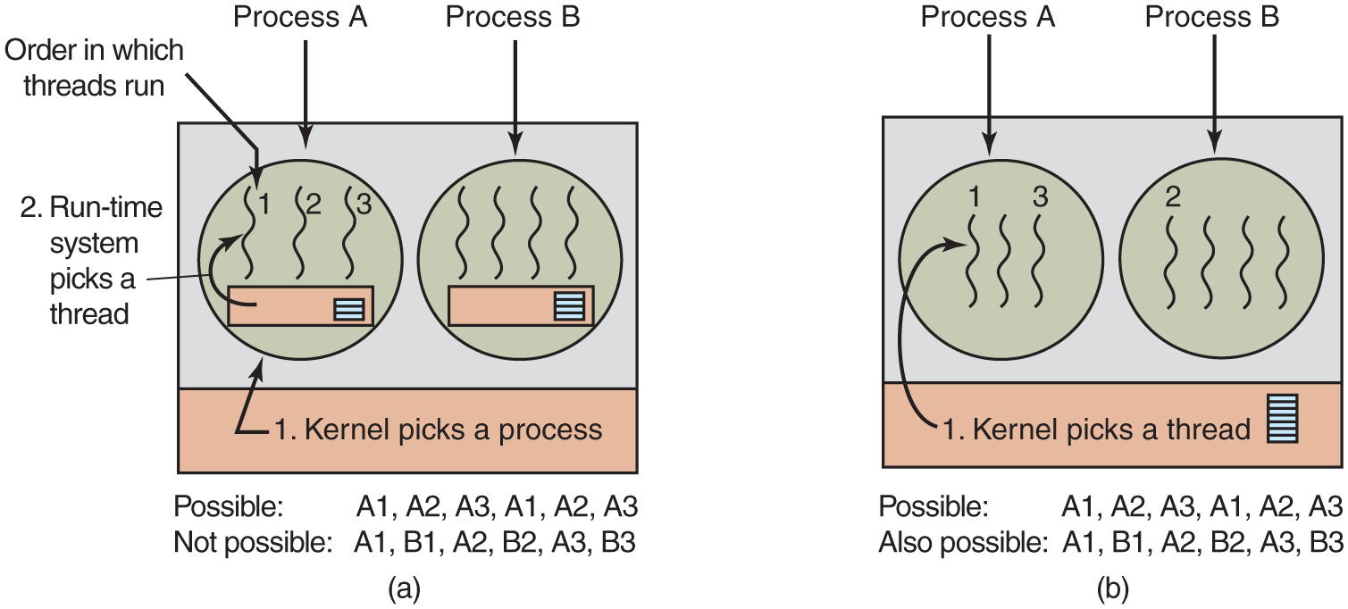
Figure 2.45
(a) Possible scheduling of user-level threads with a 50-m sec process quantum and threads that run 5 msec per C P U burst. (b) Possible scheduling of kernel-level threads with the same characteristics as (a).
Notes:
Long Description:
Part (a): A rectangular block has two horizontal partitions. The top first partition has two circles labeled Process "A" and Process B. The second partition is labeled 1. Kernel picks a process and a backward arrow points to Process "A". The Process "A" circle has three vertical wavy lines labeled 1, 2, and 3 and is categorized as Order in which threads run. A rectangular block in the circle has a backward arrow that points to thread 1 and is labeled 2. The run-time system picks a thread and one very small square with one partition in a rectangle. Similarly, the Process B circle has three vertical wavy lines, a rectangular block in the circle, and one very small square with one partition in a rectangle. There are some possibilities mentioned at the bottom of the block labeled Possible: A1, A2, A3, A1, A2, A3. Not Possible: A1, B1, A2, B2, A3, B3. Part (b): There is a rectangular block with two horizontal partitions. The top first partition has two circles labeled Process "A" and Process B. The second partition is labeled 1. Kernel picks a process and a backward arrow points to Process "A". Also, there is a rectangular block with multiple horizontal lines in the second partition. The Process "A" circle has four vertical wavy lines in which the first and third lines are labeled 1 and 3. Similarly, the Process B circle has three vertical wavy lines in which the first line is labeled 2. There are some possibilities mentioned at the bottom of the block labeled Possible: A1, A2, A3, A1, A2, A3. Not Possible: A1, B1, A2, B2, A3, B3.

Slide 54

Copyright
This work is protected by United States copyright laws and is provided solely for the use of instructors in teaching their courses and assessing student learning. Dissemination or sale of any part of this work (including on the World Wide Web) will destroy the integrity of the work and is not permitted. The work and materials from it should never be made available to students except by instructors using the accompanying text in their classes. All recipients of this work are expected to abide by these restrictions and to honor the intended pedagogical purposes and the needs of other instructors who rely on these materials.

